Slide 2
Genesis 2:7 tells us: “then the LORD God formed the man of dust from the ground and breathed into his nostrils the breath of life, and the man became a living creature.
Dust
Life
Mouth
or Man

Slide 3
Garden
Dust
Breath
Enclosure
Person
Person
Why else would the early Chinese merge two people who had life breathed into them, and one of them created from the dust of the earth, in an enclosure?

Slide 4
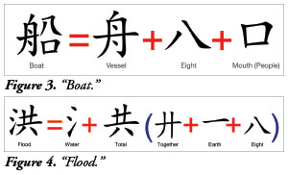
Boat
Vessel
Eight
Mouth (People)
Flood
Water
Total
Together
Earth
Eight
Genesis 7:13 tells us: "In the selfsame day entered Noah, and Shem, and Ham, and Japheth, the sons of Noah, and Noah's wife, and the three wives of his sons with them, into the ark."

