Slide 1
SPECIAL LESSON
Marriage and Family: God’s Plan
Special Lesson

Slide 2
PRAYER

Slide 3
The Cook Family Thanks You All So Much
  Prayers
  Kind Thoughts
  Words of Encouragement
  Food
  Helping with sitting, taking to chemo appointments, and many other tasks
WE COULD NOT HAVE DONE THIS WITHOUT THE BRETHREN AT CAPSHAW!
We love you more than you can ever know

Slide 4
Our Study
Growing A Good Marriage
Strengthening A Marriage
Overcoming The Challenges of Marriage
Lesson 13: Accepting Weaknesses and Differences
Lesson 14: Handling Finances Properly
Special Lesson
Lesson 15: Meekness In Marriage (next Sunday)
Parenting Biblically

Slide 5
After Marqueta was diagnosed with cancer last June 16, she decided to start writing material that could be used for a class
  She wanted to share her lessons so we could all be better christians
  We plan to take this on and finish what she started and hopefully formally publish some day
After hunting through the house, this morning I discovered her notes
Want to share some of her thoughts this afternoon
The “I” is Marqueta
She entitled it “Lessons from a Dying Woman”

Slide 6
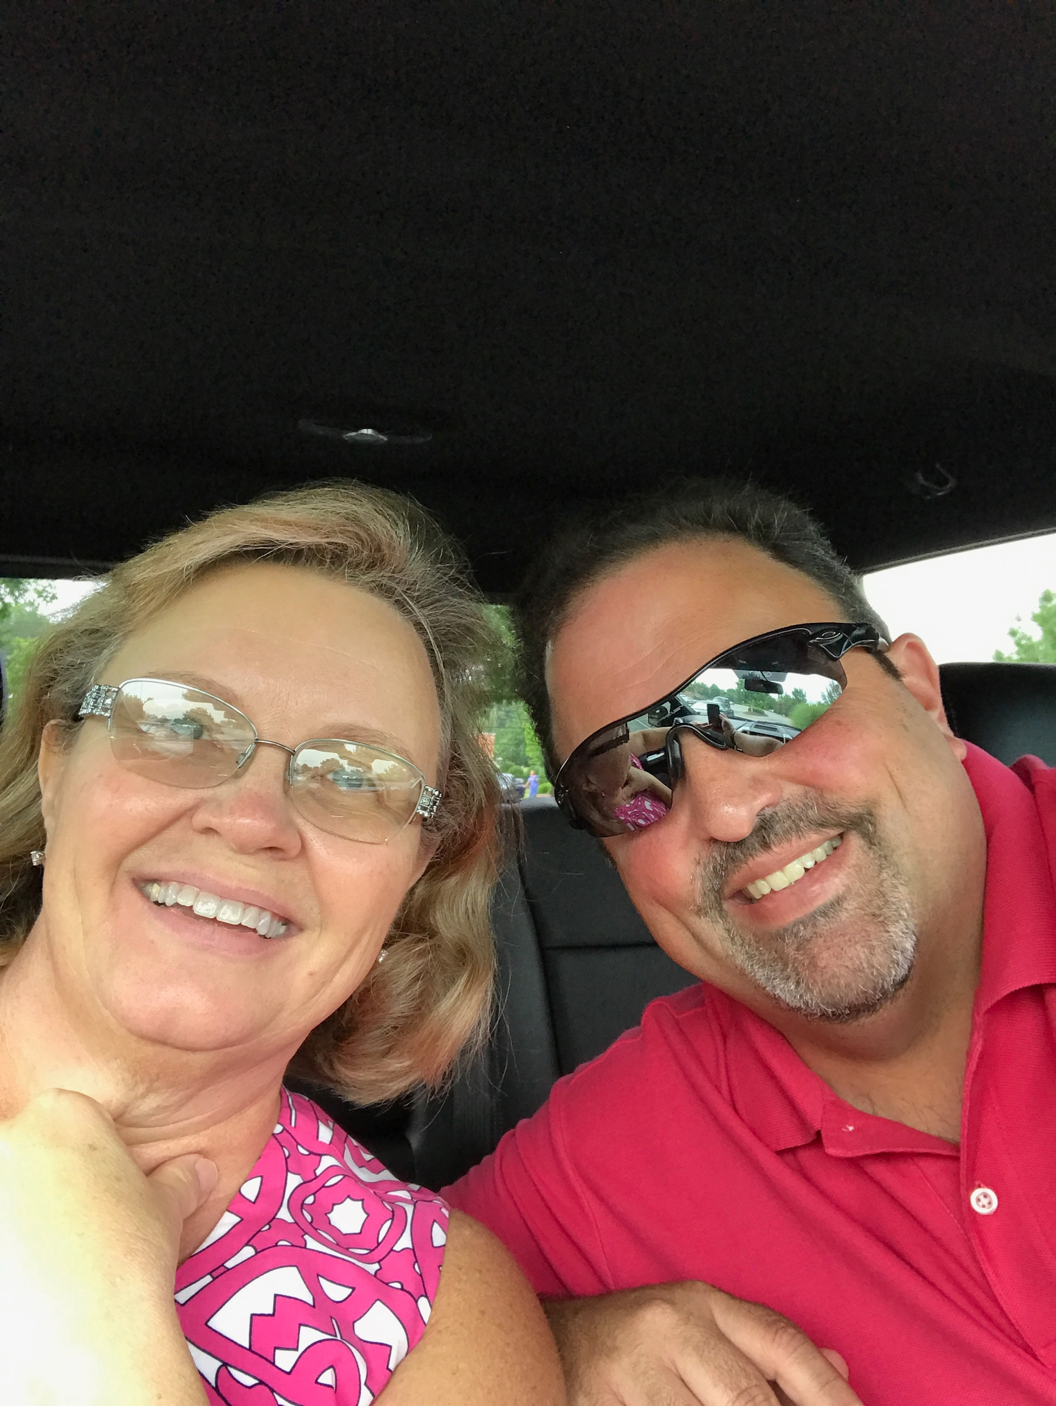
Introduction – In Her Own Words

Slide 7
Lessons from a Dying Woman
Life is a Vapor
Prayer
Fear – Controlling It
Feeling Strong / Staying Strong
Goals in Life
Evangelize
Selfishness
Trust In God

Slide 8
#1 Life is a Vapor
Read James 4:13-17
Vapor or steam can be seen but disappears quickly
We look at lives as long on the earth – think about how old a 55 year old was when you were 15
As we grow older we begin to realize “time flies”
1 Peter 1:24 reminds us that all flesh is like grass…it withers and flowers fall
Psalm 144:4 - Man is like a breath, life is like a passing shadow
Prov 27:1 – do not boast about tomorrow
James 4:16 – DO NOT BOAST
Each moment of our life is God’s to give and it will go like a vapor – fast disappearing

Slide 9
#2 Prayer
I prayed immediately upon learning of my diagnosis.
  Was initially alone in my room and had overheard the nurse in the hall. It wasn’t a formal prayer
  I simply asked “don’t let me die at Christmas”
  I felt like I should be formally praying and felt an urge to call every righteous person I know for prayers. I got it together and we prayed as a family
Our prayers are not needed by God but he desires them – we need to have that intimate relationship
He tells us to ask and we will receive an answer: Matt 7:7-8, Matt 21:22, John 14:13

Slide 10
#2 Prayer (cont’d)
What does prayer give us, how are we to pray, who are these righteous men were to have the prayers of?
Prayer can give you peace (Phil 4:6-7).
Knowing we can ask with belief it will be answered- they will be to his glory
How to pray?
  Reverently – 1 Peter 3:15, Matt 6:9
  Privately – Matt 6:6
  Often (without ceasing) – 1 Thess 5:16-18
  With Faith: James 1:5-8
The righteous are the members of the Lord’s church!
Prayer will always be a “work in progress”

Slide 11
#3 Fear – Controlling It
I wasn’t a person scared at much at all
That changed when I was diagnosed
  Fear of the future, my kids, Steve, my salvation
  Fear of what dying will be like, what my body will turn into, running out of time…so many things
I kept reading Isa 41:10 “fear not, for I am with you;be not dismayed, for I am your God;I will strengthen you, I will help you,I will uphold you with my righteous right hand.”
…and then I’d feel like a failure because I’d still get scared – what would the next test or procedure hold in store
Sometimes I’d pray every 15 min to get a hold of it, other times I reached out to my “prayer ladies”

Slide 12
#3 Fear – Controlling It (cont’d)
Listening to hymns, working on this material or just watching a positive, clean show on Hallmark
Keeping my mind full of good things . Phil 4:8 “Finally, brothers, whatever is true, whatever is honorable, whatever is just, whatever is pure, whatever is lovely, whatever is commendable, if there is any excellence, if there is anything worthy of praise, think about these things. ”
I know there is no sin in feeling afraid
  Joshua did but was told to be strong and courageous (Josh 1:9)
  David was scared (Psalm 27)
  But they overcame it through God
Cast your fear upon him: Isah 41:10, 13 and Ps 56:3-4

Slide 13
#4 Fear – Feeling Strong, Staying Strong
Prayer was critical
I also knew that many decisions were upcoming – I needed to show my family that if I was OK, they could be too
Quickly friends began to send positive messages stating they were praying for strength for me and Steve and the kids
Remember:
  Comfort in Affliction: 2 Cor 1: 3-4, Psalm 119:48-50
  Holy Spirit will Intercede: Rom 8:26-39
  Power to Faint to Renew Strength: Isa 40: 29-31
  After suffer for a little while, God will restore: 1 Pe 5:10

