Slide 2
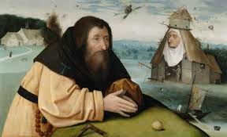
The Temptation of Saint Anthony

Slide 3
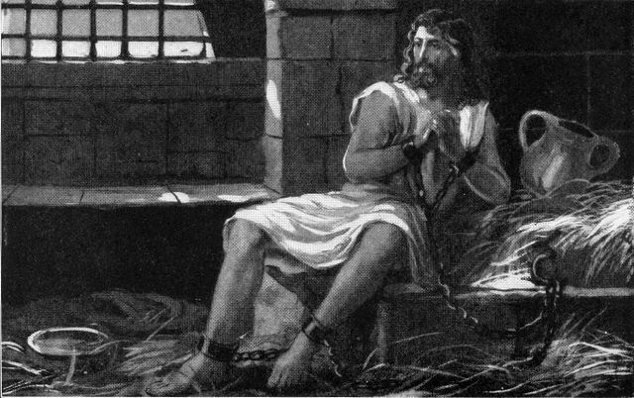
THE QUESTION
Verbalize your doubts
Go to the source
Never give up things you don’t have doubts about

Slide 4
THE QUESTION
THE ANSWER
THE PRAISE

