Slide 2
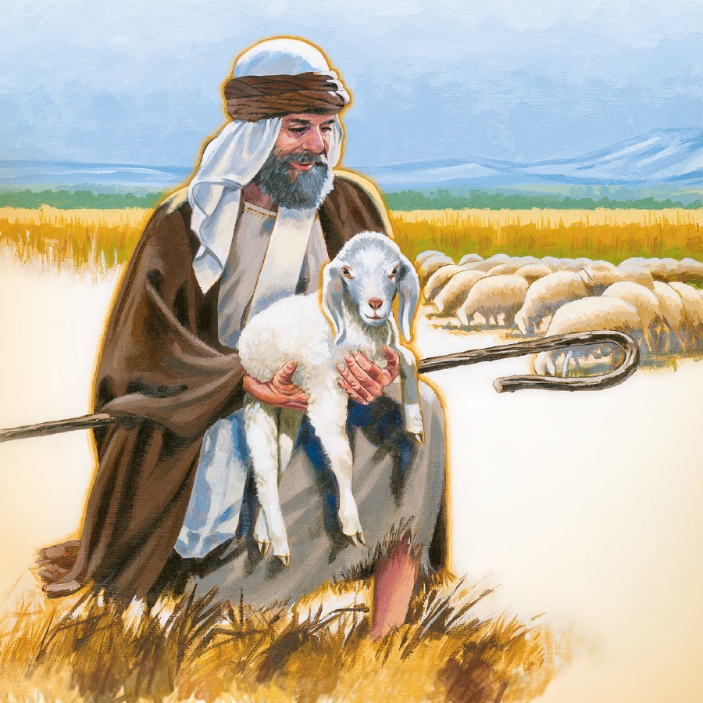
SHEPHERDS OF THE FLOCK
CHARACTER OF SHEPHERDS
OFFICE OF SHEPHERD
DUTIES OF SHEPHERDS

Slide 3
CHARACTER OF SHEPHERDS
HIS PRIVATE LIFE
HIS PUBLIC LIFE
HIS PLACE AMONG THE SAINTS

