Slide 2
LOST IN THE CREDITS
THOMAS
John 11, 14, 21
EXTRAORDINARY LESSONS FROM
ORDINARY PEOPLE

Slide 3
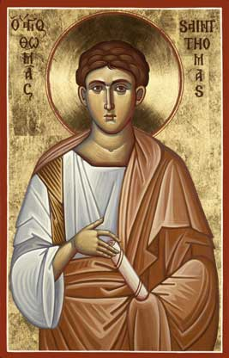
“WILLING” THOMAS
Willing to die with Christ
Willing to ask hard questions
Willing to accept the truth

