Slide 2
“You shall not boil a young goat in its mother’s milk”
EXO 23.19, 34.26; DEUT 14.21

Slide 3
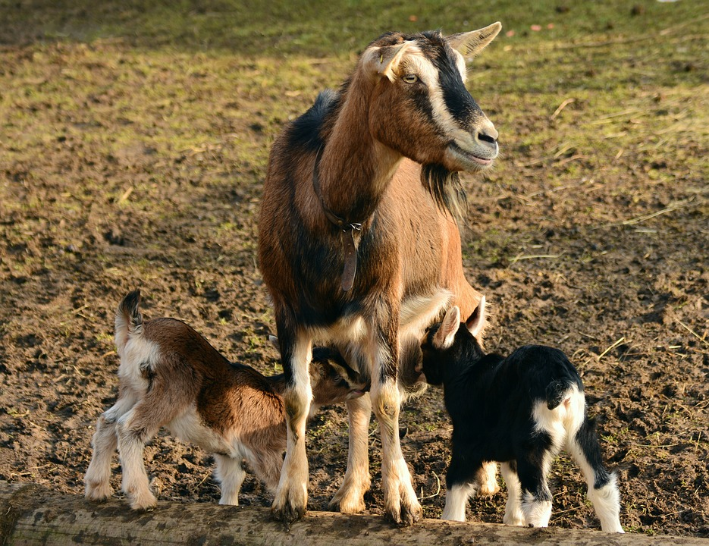
“You shall not boil a young goat in its mother’s milk”
ABOMINATIONS
“It was a custom of the ancient heathens, when they had gathered in all their fruits, to take a kid and boil it in the milk of its dam; and then, in a magical way, to go about and besprinkle with it all their trees and fields, gardens and orchards; thinking by these means to make them fruitful, that they might bring forth more abundantly in the following year.”
Clarke’s Commentary

Slide 4
“You shall not boil a young goat in its mother’s milk”
ABOMINATIONS
ALLEGORY
“Teachings about God are difficult to understand. Don’t accept new spiritual teachings about God that look too good, and too easy, to be true; they have probably been deliberately ‘cooked up’ to deceive you.”

Slide 5
“You shall not boil a young goat in its mother’s milk”
ABOMINATIONS
ALLEGORY
ABSOLUTES

