Slide 2
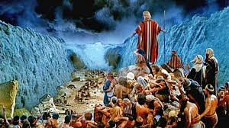

Slide 3
ISRAEL AT THE RED SEA
UNDENIABLE FACT- GOD
UNCERTAIN FAITH- ISRAEL
UNBEATABLE FOE- EGYPT

