Slide 2
Matthew 6:22-23
²² “The lamp of the body is the eye. If therefore your eye is good, your whole body will be full of light. ²³ But if your eye is bad, your whole body will be full of darkness. If therefore the light that is in you is darkness, how great is that darkness!

Slide 3
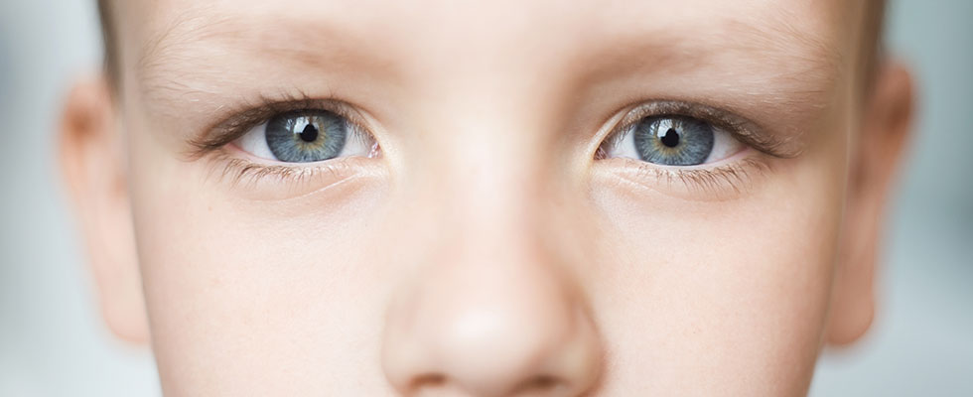
The Influence That Our Devices Have On Us

Slide 4
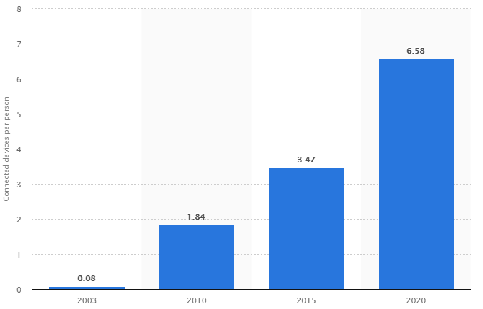
Number of Network Connected Devices
Per Person Around the World

Slide 5
The Influence That Our Devices Have On Us
This book, written only a year after the first webpage was launched, was published by Dr. Philip Patterson. It said that the greatest single danger that video (in all its forms) poses is the idea that video has no influence on us. Patterson argues that this false notion is more dangerous than the actual images themselves.
When people consume media with this in mind, they become more vulnerable to the media’s influence.
In his research (using movies and TV images) Dr. Patterson found that the TV does influence us in a variety of ways.

Slide 6
The Influence That Our Devices Have On Us
Shapes Our Values

Slide 7
The Influence That Our Devices Have On Us
Shapes Our Values
Causes Unrealistic Expectations

Slide 8
The Influence That Our Devices Have On Us
Shapes Our Values
Causes Unrealistic Expectations
Numbs Sensitivity

Slide 9
The Influence That Our Devices Have On Us
Shapes Our Values
Causes Unrealistic Expectations
Numbs Sensitivity
Reduces Resistance to Sins

Slide 10
The Influence That Our Devices Have On Us
Shapes Our Values
Causes Unrealistic Expectations
Numbs Sensitivity
Reduces Resistance to Sins
Replaces Relationships

Slide 11
The Influence That Our Devices Have On Us
Shapes Our Values
Causes Unrealistic Expectations
Numbs Sensitivity
Reduces Resistance to Sins
Replaces Relationships
Wastes Time

Slide 12
The SMART Way To Control Our Devices
Select What You Are Going to Watch, Listen, Read, etc.

Slide 13
Philippians 4:8
⁸ Finally, brethren, whatever things are true, whatever things are noble, whatever things are just, whatever things are pure, whatever things are lovely, whatever things are of good report, if there is any virtue and if there is anything praiseworthy – meditate on these things.

Slide 14
Proverbs 15:14
¹⁴ The heart of him who has understanding seeks knowledge,
But the mouth of fools feeds on foolishness.

Slide 15
Psalms 119:37
³⁷ Turn away my eyes from looking at vanity,
And revive me in Your ways.

Slide 16
The SMART Way To Control Our Devices
Select What You Are Going to Watch, Listen, Read, etc.
Manage Your Devices

Slide 17
Ephesians 5:15-16
¹⁵ See then that you walk circumspectly, not as fools but as wise,
¹⁶ redeeming the time, because the days are evil.

Slide 18
Ecclesiastes 3:1
¹ To everything there is a season,
A time for every purpose under heaven:

Slide 19
The SMART Way To Control Our Devices
Select What You Are Going to Watch, Listen, Read, etc.
Manage Your Devices
Actively Evaluate What You See

Slide 20
Proverbs 14:15
¹⁵ The simple believes every word,
But the prudent considers well his steps.

Slide 21
1 Thessalonians 5:21-22
²¹ Test all things; hold fast what is good.
²² Abstain from every form of evil.

Slide 22
The SMART Way To Control Our Devices
Select What You Are Going to Watch, Listen, Read, etc.
Manage Your Devices
Actively Evaluate What You See
Regulate How Much Time You Have

Slide 23
1 Corinthians 6:12
¹² All things are lawful for me, but all things are not helpful. All things are lawful for me, but I will not be brought under the power of any.

Slide 24
The SMART Way To Control Our Devices
Select What You Are Going to Watch, Listen, Read, etc.
Manage Your Devices
Actively Evaluate What You See
Regulate How Much Time You Have
Turn It Off

Slide 25
It’s Our Choice
Everything that comes in, we chose it!
With so much information coming at us daily, we have to be SMART and take control!

Slide 26
Psalms 101:3
³ I will set nothing wicked before my eyes;
I hate the work of those who fall away;
It shall not cling to me.

