Slide 2
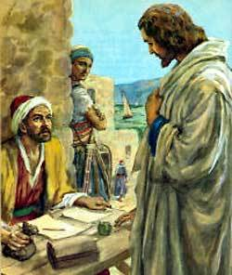
COMPLAINING TO GOD
“Lord, why won’t You?”
“Lord, how could You?”

Slide 3
COMPLAINING TO CHRIST
“Lord, how could You?”
“Lord, why won’t You?”

