Slide 2
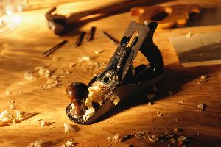
CARPENTERS SON
COMMUNICATION
COMPASSION
CROSS

