Slide 1
An identity crisis
Lesson Twelve

Slide 2
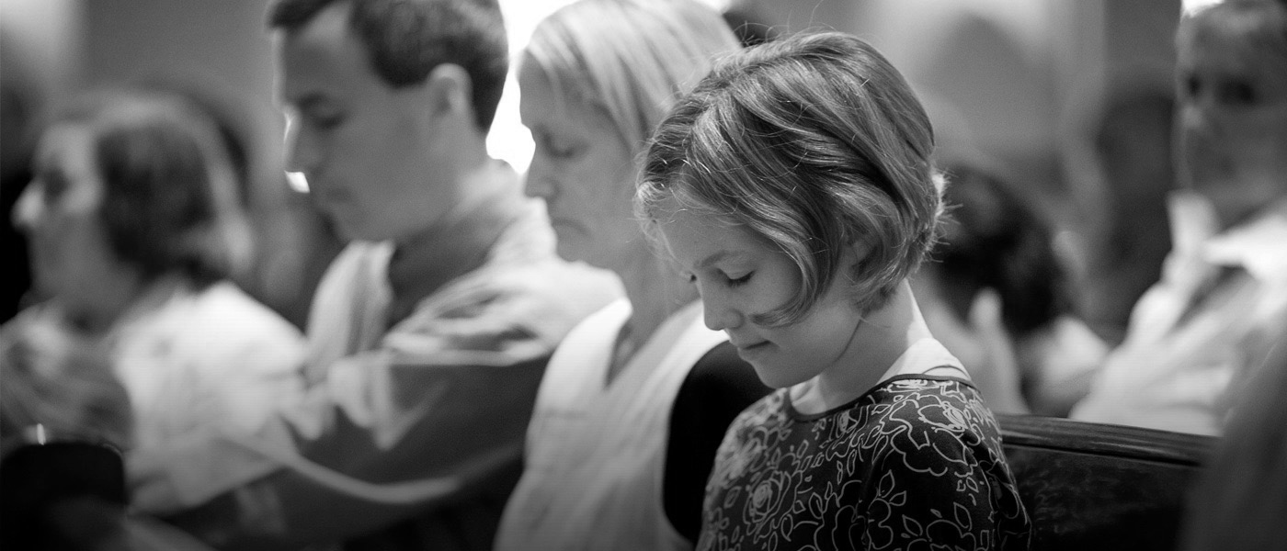
prayer

Slide 3
Aspiring to the “office”
1 Timothy 3:1-6
3 This is a faithful saying: If a man desires the office of a bishop, he desires a good work. 2 A bishop then must be blameless, the husband of one wife, temperate, sober-minded, of good behavior, hospitable, able to teach; 3 not given to wine, not violent, not greedy for money, but gentle, not quarrelsome, not covetous; 4 one who rules his own house well, having his children in submission with all reverence 5 (for if a man does not know how to rule his own house, how will he take care of the church of God?); 6 not a novice, lest being puffed up with pride he fall into the same condemnation as the devil.

Slide 4
Aspiring to the “office”
1 Timothy 3:1-6
What is normally meant by the term “office”?

Slide 5
Aspiring to the “office”
Old Testament illustrates description of the role in Exodus 3:16

Slide 6
Aspiring to the “office”
Exodus 3:16
16 Go and gather the elders of Israel together, and say to them, ‘The Lord God of your fathers, the God of Abraham, of Isaac, and of Jacob, appeared to me, saying, “I have surely visited you and seen what is done to you in Egypt;

Slide 7
Aspiring to the “office”
What is implied by our use of the word “elder” and the word used in this passage?

Slide 8
Aspiring to the “office”
If the term used for this role implies age…
Without additional descriptions, how would you pick your elders…?

Slide 9
Presbyters
Duet. 31:9
9 So Moses wrote this law and delivered it to the priests, the sons of Levi, who bore the ark of the covenant of the Lord, and to all the elders of Israel.
Numbers 11:16-17
16 So the Lord said to Moses: “Gather to Me seventy men of the elders of Israel, whom you know to be the elders of the people and officers over them; bring them to the tabernacle of meeting, that they may stand there with you. 17 Then I will come down and talk with you there. I will take of the Spirit that is upon you and will put the same upon them; and they shall bear the burden of the people with you, that you may not bear it yourself alone.

Slide 10
Presbyters
Leadership
Teachers (along with priests)
Deuteronomy 31
Judging (decision making, application of God’s law in practical ways)
Numbers 11:16-17
Leaders – not for waiting on “tables” but for the teaching of the gospel
Acts 6:1-7

Slide 11
Presbyters
Acts 6:1-7
6 Now in those days, when the number of the disciples was multiplying, there arose a complaint against the Hebrews by the Hellenists, because their widows were neglected in the daily distribution. 2 Then the twelve summoned the multitude of the disciples and said, “It is not desirable that we should leave the word of God and serve tables. 3 Therefore, brethren, seek out from among you seven men of good reputation, full of the Holy Spirit and wisdom, whom we may appoint over this business; 4 but we will give ourselves continually to prayer and to the ministry of the word.”
5 And the saying pleased the whole multitude. And they chose Stephen, a man full of faith and the Holy Spirit, and Philip, Prochorus, Nicanor, Timon, Parmenas, and Nicolas, a proselyte from Antioch, 6 whom they set before the apostles; and when they had prayed, they laid hands on them.
7 Then the word of God spread, and the number of the disciples multiplied greatly in Jerusalem, and a great many of the priests were obedient to the faith.

Slide 12
Episcopas
Overseer
1 Peter 5:1-3
1 Peter 2
Acts 1
On the look-out (as in watchman)
How does an effective watchman guard his post?
Term is used interchangeably with episceptimi – to “visit”
What is our definition of visiting in this present age?

Slide 13
Poimaino (Pastor)
Ezekiel 3:16
Pastor is NOT a title, it is descriptive
More aptly referred to as Shepherd…
Because it protects the flock (security)
Feeds the sheep (food and water)
The opposite of a corporate supervisor watching from his catwalk
Cowboys chase – Shepherds lead
Hebrews 13:7, 17

Slide 14
How are elders different from every other Christians?
We have obligations to watch over each other don’t we?
(new brother or sister in adulterous relationship)
Jude 1:23
Do we not evangelize and teach others?
Titus 2:1
Are we not to preserve our reputation?
1 Peter 4:7-10

Slide 15
So what exactly do elders/shepherds do? Do we really need them?
What would you want a leader to do for you?
What do you expect from your elders?
What do you expect from your deacons?
But these are the wrong questions. The right question is...

Slide 16
What does GOD expect from elders?

Slide 17
Guide – Guard – Direct
Guidance in the treacherous world to reach heaven
Protection from false teachers and worldly temptations
Direction towards how to improve as:
Evangelists
Christians
Fathers
Mothers
Brothers
Sisters
Leaders
Bosses
Employees
Servants
Sons
Daughters

Slide 18
Shepherds aren’t CEO’s or accountants or maintenance men…
We do not need an elder to buy brooms
We do not need an elder to ONLY negotiate the deal we get repaving the parking lot
We do not need elders for the express purpose of cleaning the church building
GOD did NOT command us to elect leaders from among our midst to wait on tables

