Slide 2
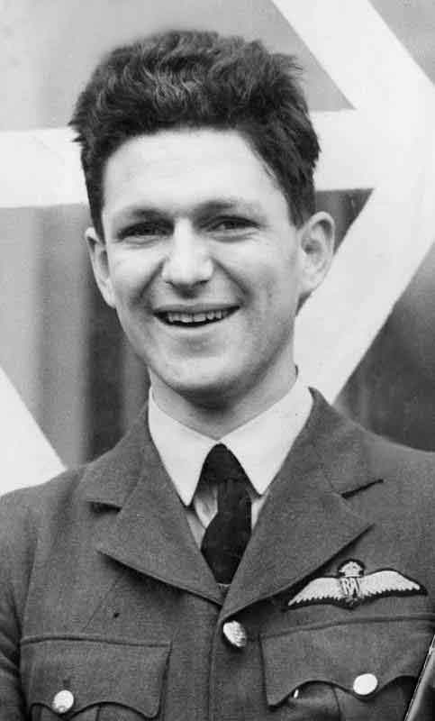
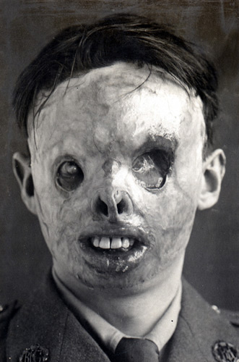

Slide 3
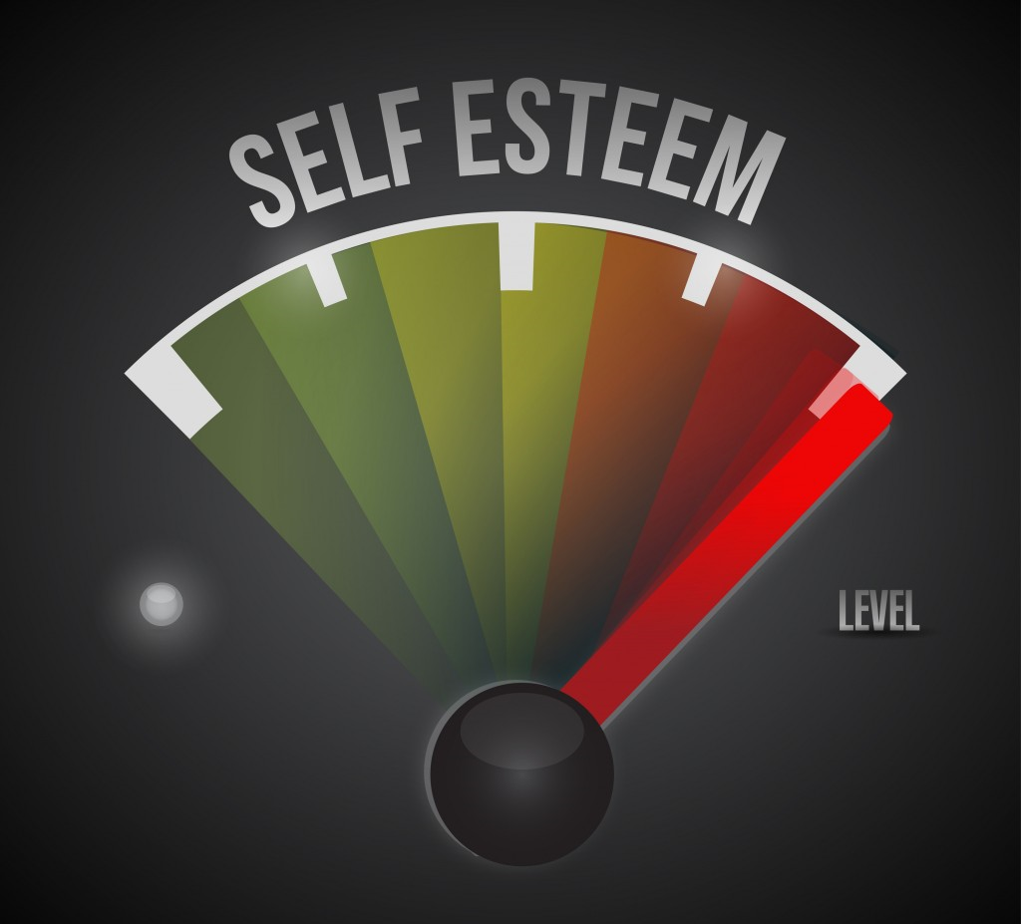

Slide 4
LOVING SELF IS NOT
Feelings of Inferiority
Self Hatred
Underestimating our abilities
Humility is not thinking less of yourself, its thinking of yourself less

Slide 5
LOVING SELF INVOLVES
NOURISHING
CHERISHING

Slide 6
WHY LOVE SELF?
Because God created us
Because Christ died for us
Because the Spirit gifted us

