Slide 2
WHAT IS HIGHER POWER?
DrugRehab.com
“A higher power is something greater than us. For many people, God is a higher power. For others, a higher power isn’t associated with religion or a deity. It’s a connection that we share with all living things. Some people don’t try to understand their higher power. They believe humans can’t comprehend it. Regardless of what a higher power is to you, having faith in a higher power can benefit your recovery.”

Slide 3
WHAT IS HIGHER POWER?
Sunrise Ranch (drug recovery)
“Another strong term is ‘greater power.’ Here the person is asked to question, “Is it possible that there is something greater than myself?” For some this ‘greater’ is intuition, science or the environmental elements. For others it is something along the lines of a religious practice including Buddha, God or Jesus. A greater power is often viewed as a source of inspiration and comfort which is essential to recovery. This greater power is often a symbol for opening up one’s mind to new concepts and ideas.”

Slide 4
WHAT IS HIGHER POWER?
TheFreedomCenter.com (Higher Power for Atheists and Agnostics: 6 Alternatives to God)
Nature
Science
The Universe
Music
Love
Humanity

Slide 5
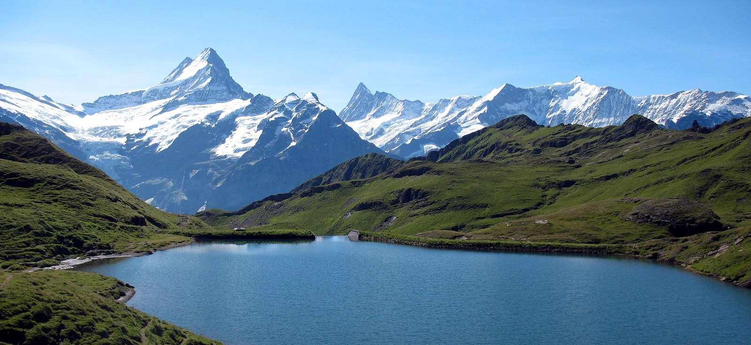
NATURE
Wildlife
Animals
Plants
Natural Disasters
Tornado
Hurricane
Earthquake
Volcano

Slide 6
GOD IN NATURE
Genesis 1:9-12; 20-25
Psalm 95:4-6
Job 36:24-37:14

Slide 7
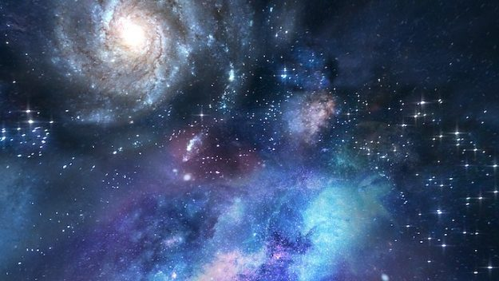
SCIENCE & THE UNIVERSE
Evolution
Man evolved (and continues to evolve) from molecules that “joined force”
The Big Bang
An explosion created the universe

Slide 8
GOD IN SCIENCE AND THE UNIVERSE
Genesis 1:14-19; 26-28
Hebrews 11:3

Slide 9
Evoke Emotion
Lyrics
Melody

Slide 10
GOD IN MUSIC
Ephesians 5:19
Hebrews 2:12
Colossians 3:16

Slide 11
LOVE & HUMANITY

Slide 12
GOD IS LOVE
1 John 4:7-11
Mark 12:29-31
Matthew 7:12

