Slide 2
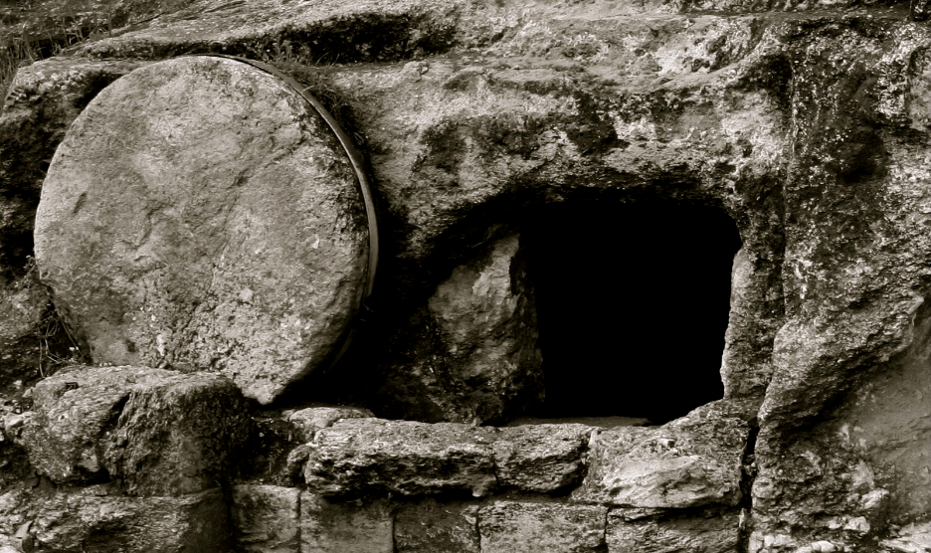
Why do you believe
in the resurrection?

Slide 3
Why do you believe in the resurrection?
John 5:28-29
"Do not marvel at this; for an hour is coming, in which all who are in the tombs will hear His voice, and will come forth; those who did the good deeds to a resurrection of life, those who committed the evil deeds to a resurrection of judgment.

Slide 4
Why do you believe in the resurrection?
Jesus told His disciples He would be raised from the dead
Matthew 16:21
From that time Jesus began to show His disciples that He must go to Jerusalem, and suffer many things from the elders and chief priests and scribes, and be killed, and be raised up on the third day.

Slide 5
Why do you believe in the resurrection?
Jesus told His disciples He would be raised from the dead
Luke 9:21-22
But He warned them and instructed them not to tell this to anyone, saying, "The Son of Man must suffer many things and be rejected by the elders and chief priests and scribes, and be killed and be raised up on the third day."

Slide 6
Why do you believe in the resurrection?
His disciples refused to believe that He was raised
Mark 16:11-14
After that, He appeared in a different form to two of them while they were walking along on their way to the country. They went away and reported it to the others, but they did not believe them either. Afterward He appeared to the eleven themselves as they were reclining at the table; and He reproached them for their unbelief and hardness of heart, because they had not believed those who had seen Him after He had risen.

Slide 7
Why do you believe in the resurrection?
His disciples did not understand what the resurrection meant
John 21:2-3
Simon Peter, and Thomas called Didymus, and Nathanael of Cana in Galilee, and the sons of Zebedee, and two others of His disciples were together. Simon Peter said to them, "I am going fishing." They said to him, "We will also come with you." They went out and got into the boat; and that night they caught nothing.

Slide 8
Why do you believe in the resurrection?
Evidences of the Lord’s resurrection
The stone was rolled away, the Roman seal was broken.
The tomb was empty, a new tomb of Joseph of Arimathea.
The linen wrappings and the facecloth were left in the tomb.

Slide 9
Why do you believe in the resurrection?
Evidences of the Lord’s resurrection
4. The roman guards reported what happened
and they were paid a large sum of money to
say His disciples had stolen Him away while
they slept.

Slide 10
Why do you believe in the resurrection?
Evidences of the Lord’s resurrection
5. His appearances to many: : Mary Magdalene,
other women coming to the tomb, Peter, two
disciples on the road to Emmaus, the disciples
without Thomas, the disciples with Thomas,
to seven disciples at the Sea of Galilee, to the
eleven at a mountain in Galilee, over 500 at
one time (1 Cor. 15).

Slide 11
Why do you believe in the resurrection?
Why would they give their lives if there is no resurrection?
Acts 7:55-60
When they had driven him out of the city, they began stoning him; and the witnesses laid aside their robes at the feet of a young man named Saul. They went on stoning Stephen as he called on the Lord and said, "Lord Jesus, receive my spirit!" Then falling on his knees, he cried out with a loud voice, "Lord, do not hold this sin against them!" Having said this, he fell asleep.

Slide 12
Why do you believe in the resurrection?
Why would they give their lives if there is no resurrection?
Acts 12:1-2
Now about that time Herod the king laid hands on some who belonged to the church in order to mistreat them. And he had James the brother of John put to death with a sword.

Slide 13
Why do you believe in the resurrection?
Paul’s description of the resurrection
1 Corinthians 15:16-20
For if the dead are not raised, not even Christ has been raised; and if Christ has not been raised, your faith is worthless; you are still in your sins. Then those also who have fallen asleep in Christ have perished. If we have hoped in Christ in this life only, we are of all men most to be pitied. But now Christ has been raised from the dead, the first fruits of those who are asleep.

Slide 14
Why do you believe in the resurrection?
Paul’s description of the resurrection
1 Corinthians 15:50-57
For this perishable must put on the imperishable, and this mortal must put on immortality. But when this perishable will have put on the imperishable, and this mortal will have put on immortality, then will come about the saying that is written, "DEATH IS SWALLOWED UP in victory. "O DEATH, WHERE IS YOUR VICTORY? O DEATH, WHERE IS YOUR STING?" The sting of death is sin, and the power of sin is the law; but thanks be to God, who gives us the victory through our Lord Jesus Christ.

Slide 15
Why do you believe
in the resurrection?

