Slide 2




“These Young People Just Aren’t Interested In The Lord”

Slide 3

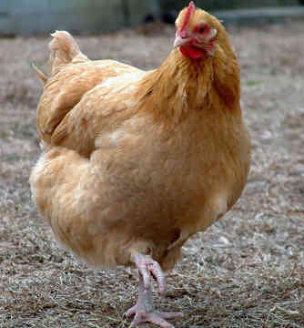

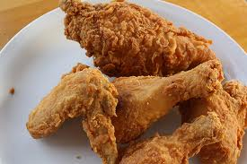

Slide 4
“These Young People Just Aren’t Interested In The Lord”
They choose to reject what their parents taught them.

Slide 5

They choose to reject what their parents taught them.
Proverbs 22:6
2 Kings 18:1-6; 21:1-9
2 Corinthians 5:10
Proverbs 29:15; 19:18
Ephesians 6:4
“Parents, what you do may send your children to hell!”

Slide 6
“These Young People Just Aren’t Interested In The Lord”
They choose to reject what their parents taught them.
Their storehouse is empty.

Slide 7

Their storehouse is empty.
Matthew 12:24
Matthew 12:34-35
Proverbs 4:23
Psalm 78:5-8
Ephesians 6:4
“Parents have to equip their children with the spiritual tools they need for this life.”

Slide 8
“These Young People Just Aren’t Interested In The Lord”
They choose to reject what their parents taught them.
Their storehouse is empty.
They missed important opportunities.

Slide 9

They missed important opportunities.
Deuteronomy 6:7-9
Ephesians 5:15-16

Slide 10
Make the most of your spiritual opportunities!

