Slide 2
When Life Hands You Lemons…

Slide 3
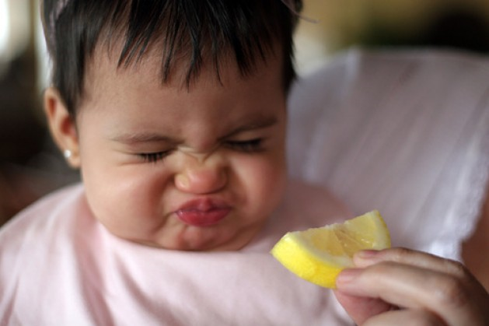
Make A Sour Face
James 5:7-11
Phil. 2:14-16

Slide 4
Make Lemonade
Rom. 8:28
James 1:2-4

Slide 5
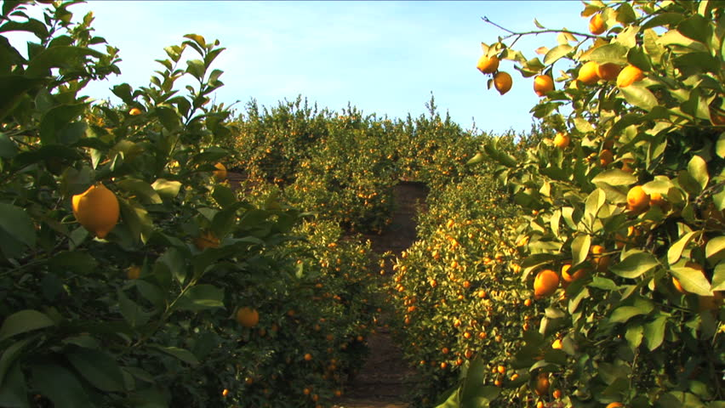
Plant A Lemon Grove
2 Cor. 12:7-10
Matt. 5:3-12

