Slide 2
Worship:
What Does God Want?

Slide 3
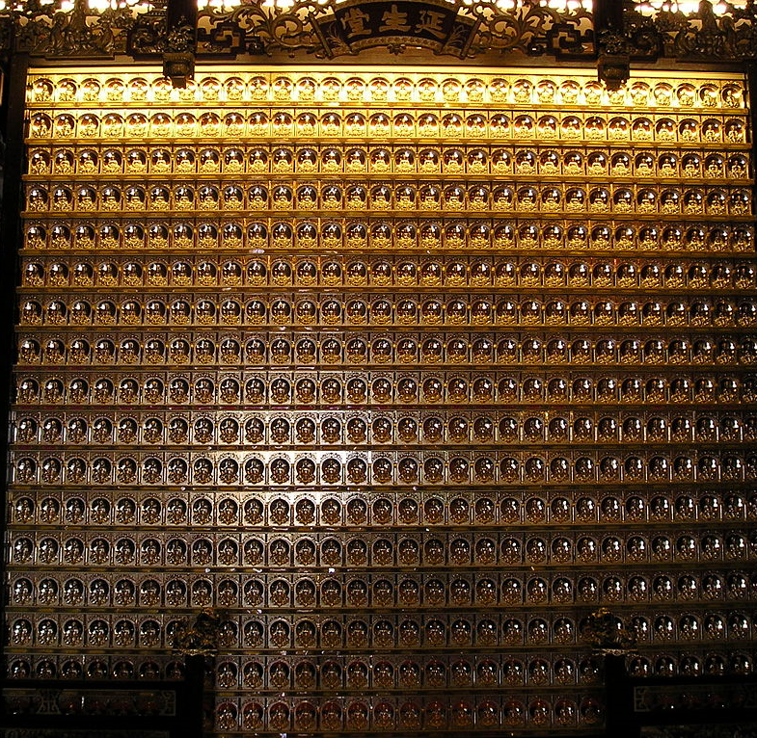
Worship: What Does God Want?
Not Will Worship-

Slide 4
Worship: What Does God Want?
Not Will Worship-
God says, "I am the Potter, you are the clay" (Isa. 64:8) but we want it reversed.
Man is to worship in a way that brings glory to the Creator rather than to the one created. (1 Cor. 2:9-13; 2 Tim. 3:16-17).

Slide 5
Worship: What Does God Want?
God Wants Our Best-
When God's children collectively gather to worship, God deserves man's best.

Slide 6
Worship: What Does God Want?
God Wants Our Best-
This includes three things:
He wants your heart. John 4:24; Matt. 15:8
He wants your reverence. Psa. 96:7-9
He wants your passion. Mal. 1:13

Slide 7
Worship: What Does God Want?
Worship to God is about what He wants, not what we want?

