Slide 2
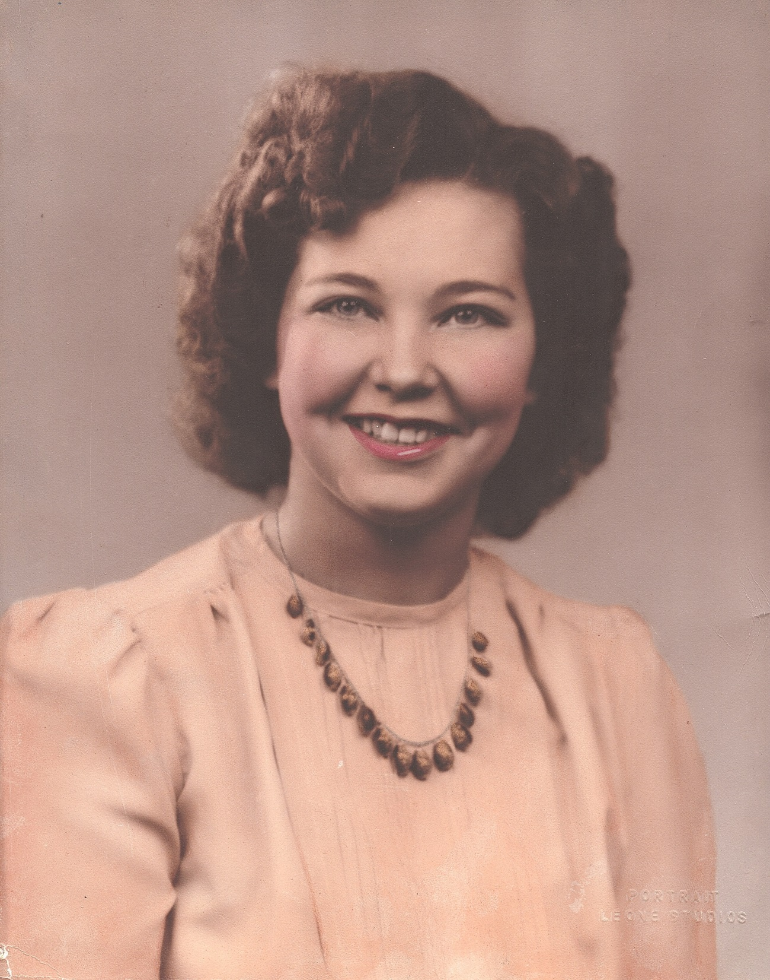

Slide 3
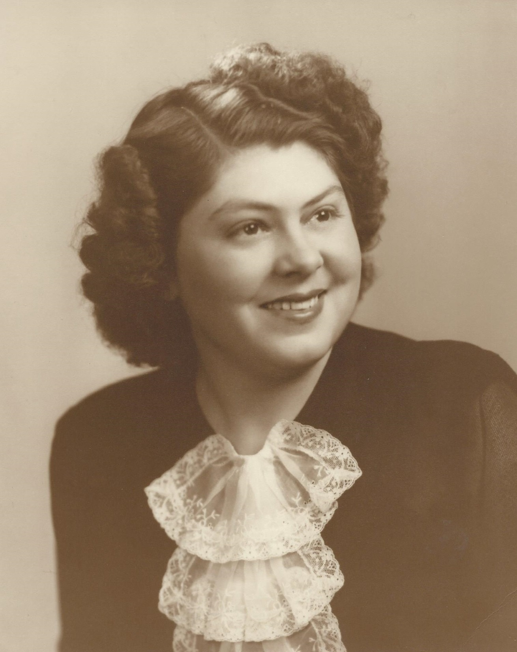

Slide 5
HOW DOES THE SERVANT OF THE LORD
APPEAR UNTO OTHERS?

Slide 6
How does the servant of the Lord appear unto others?
Colossians 3:9-10
Do not lie to one another, since you laid aside the old self with its evil practices, and have put on the new self who is being renewed to a true knowledge according to the image of the One who created him

Slide 7
How does the servant of the Lord appear unto others?
How do we treat our family, those we have contact with?
Colossians 3:12-15
So, as those who have been chosen of God, holy and beloved, put on a heart of compassion, kindness, humility, gentleness and patience; bearing with one another, and forgiving each other, whoever has a complaint against anyone; just as the Lord forgave you, so also should you. Beyond all these things put on love, which is the perfect bond of unity. Let the peace of Christ rule in your hearts, to which indeed you were called in one body; and be thankful.

Slide 8
How does the servant of the Lord appear unto others?
Do we appear to show the strength of our convictions?
Acts 4:7-13
He is the STONE WHICH WAS REJECTED by you, THE BUILDERS, but WHICH BECAME THE CHIEF CORNER stone. And there is salvation in no one else; for there is no other name under heaven that has been given among men by which we must be saved.“ Now as they observed the confidence of Peter and John and understood that they were uneducated and untrained men, they were amazed, and began to recognize them as having been with Jesus.

Slide 9
How does the servant of the Lord appear unto others?
How do we dress to influence people for the Lord?
1 Timothy 2:8-10
Therefore I want the men in every place to pray, lifting up holy hands, without wrath and dissension. Likewise, I want women to adorn themselves with proper clothing, modestly and discreetly, not with braided hair and gold or pearls or costly garments, but rather by means of good works, as is proper for women making a claim to godliness.

Slide 10
How does the servant of the Lord appear unto others?
How do we dress to influence people for the Lord?
1 Peter 3:3-4
Your adornment must not be merely external — braiding the hair, and wearing gold jewelry, or putting on dresses; but let it be the hidden person of the heart, with the imperishable quality of a gentle and quiet spirit, which is precious in the sight of God.

Slide 11
How does the servant of the Lord appear unto others?
How do we talk to and with others?
Ephesians 4:29-32
Let no unwholesome word proceed from your mouth, but only such a word as is good for edification according to the need of the moment, so that it will give grace to those who hear. Do not grieve the Holy Spirit of God, by whom you were sealed for the day of redemption. Let all bitterness and wrath and anger and clamor and slander be put away from you, along with all malice. Be kind to one another, tender-hearted, forgiving each other, just as God in Christ also has forgiven you.

Slide 12
How does the servant of the Lord appear unto others?
How do we appear to influence others to seek the Lord?
Matthew 5:13
"You are the salt of the earth; but if the salt has become tasteless, how can it be made salty again? It is no longer good for anything, except to be thrown out and trampled under foot by men.

Slide 13
How does the servant of the Lord appear unto others?
Do we appear to grumble and complain about life?
Philippians 2:14-16
Do all things without grumbling or disputing; so that you will prove yourselves to be blameless and innocent, children of God above reproach in the midst of a crooked and perverse generation, among whom you appear as lights in the world, holding fast the word of life, so that in the day of Christ I will have reason to glory because I did not run in vain nor toil in vain.

Slide 14
What must I do to be saved?
Hear the gospel
Matthew 13:23
Believe in the Lord
Mark 16:16
Repent of your sins
Acts 2:38
Confess your belief
Romans 10:10
Be baptized for remission of sin
Acts 22:16

