Slide 2
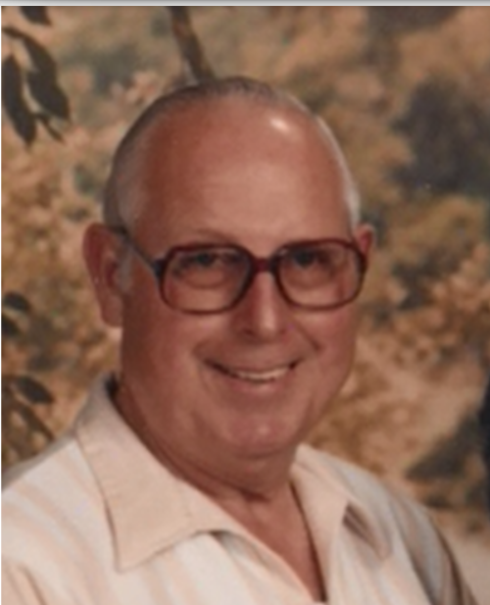

Slide 3
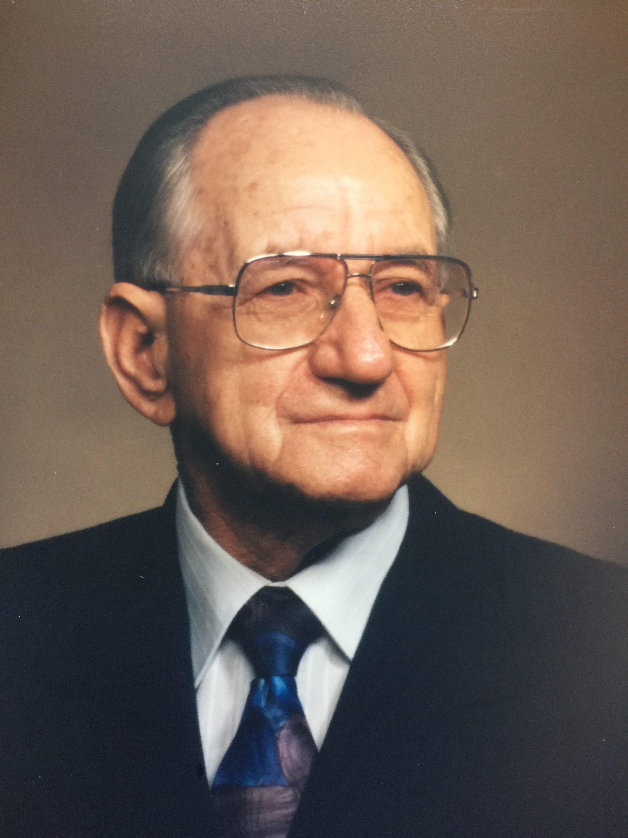

Slide 4
No one like Jesus
John 6:60-68
"What then if you see the Son of Man ascending to where He was before? It is the Spirit who gives life; the flesh profits nothing; the words that I have spoken to you are spirit and are life. But there are some of you who do not believe." For Jesus knew from the beginning who they were who did not believe, and who it was that would betray Him. And He was saying, "For this reason I have said to you, that no one can come to Me unless it has been granted him from the Father." As a result of this many of His disciples withdrew and were not walking with Him anymore. So Jesus said to the twelve, "You do not want to go away also, do you?" Simon Peter answered Him, "Lord, to whom shall we go? You have words of eternal life.

Slide 5
No one like Jesus
No other birth like Jesus’ birth
Isaiah 7:14
"Therefore the Lord Himself will give you a sign: Behold, a virgin will be with child and bear a son, and she will call His name Immanuel.

Slide 6
No one like Jesus
No other birth like Jesus’ birth
Matthew 1:18-21
Now the birth of Jesus Christ was as follows: when His mother Mary had been betrothed to Joseph, before they came together she was found to be with child by the Holy Spirit. And Joseph her husband, being a righteous man and not wanting to disgrace her, planned to send her away secretly. But when he had considered this, behold, an angel of the Lord appeared to him in a dream, saying, "Joseph, son of David, do not be afraid to take Mary as your wife; for the Child who has been conceived in her is of the Holy Spirit. She will bear a Son; and you shall call His name Jesus, for He will save His people from their sins."

Slide 7
No one like Jesus
No other life like Jesus’ life
Matthew 20:25-28
But Jesus called them to Himself and said, "You know that the rulers of the Gentiles lord it over them, and their great men exercise authority over them. It is not this way among you, but whoever wishes to become great among you shall be your servant, and whoever wishes to be first among you shall be your slave; just as the Son of Man did not come to be served, but to serve, and to give His life a ransom for many."

Slide 8
No one like Jesus
No other death like Jesus’ death
1 John 4:10
In this is love, not that we loved God, but that He loved us and sent His Son to be the propitiation for our sins.

Slide 9
No one like Jesus
No one equal to Him in the knowledge of creation
John 1:1-3
In the beginning was the Word, and the Word was with God, and the Word was God. He was in the beginning with God. All things came into being through Him, and apart from Him nothing came into being that has come into being.

Slide 10
No one like Jesus
No one equal to Him in the knowledge of creation
Colossians 1:15-16
He is the image of the invisible God, the firstborn of all creation. For by Him all things were created, both in the heavens and on earth, visible and invisible, whether thrones or dominions or rulers or authorities — all things have been created through Him and for Him.

Slide 11
No one like Jesus
No one equal to Him in knowledge of fulfilling the Old Law
Isaiah 61:1
The Spirit of the Lord GOD is upon me,
Because the LORD has anointed me
To bring good news to the afflicted;
He has sent me to bind up the brokenhearted,
To proclaim liberty to captives
And freedom to prisoners;

Slide 12
No one like Jesus
No one equal to Him in knowledge of fulfilling the Old Law
Luke 4:16-21
And He came to Nazareth, where He had been brought up; and as was His custom, He entered the synagogue on the Sabbath, and stood up to read. And the book of the prophet Isaiah was handed to Him. And He opened the book and found the place where it was written,
"THE SPIRIT OF THE LORD IS UPON ME,
BECAUSE HE ANOINTED ME TO PREACH THE GOSPEL TO THE POOR.
HE HAS SENT ME TO PROCLAIM RELEASE TO THE CAPTIVES,
AND RECOVERY OF SIGHT TO THE BLIND,
TO SET FREE THOSE WHO ARE OPPRESSED,
TO PROCLAIM THE FAVORABLE YEAR OF THE LORD."

Slide 13
No one like Jesus
No one equal to Him in knowledge of the future
Luke 22:31-34
"Simon, Simon, behold, Satan has demanded permission to sift you like wheat; but I have prayed for you, that your faith may not fail; and you, when once you have turned again, strengthen your brothers." But he said to Him, "Lord, with You I am ready to go both to prison and to death!" And He said, "I say to you, Peter, the rooster will not crow today until you have denied three times that you know Me."

Slide 14
No one like Jesus
No one equal to Him in knowledge of the future
John 13:24-27
So Simon Peter gestured to him, and said to him, "Tell us who it is of whom He is speaking." He, leaning back thus on Jesus' bosom, said to Him, "Lord, who is it?" Jesus then answered, "That is the one for whom I shall dip the morsel and give it to him." So when He had dipped the morsel, He took and gave it to Judas, the son of Simon Iscariot. After the morsel, Satan then entered into him. Therefore Jesus said to him, "What you do, do quickly."

Slide 15
No one like Jesus
No one like Him in His motives
Philippians 2:5-8
Have this attitude in yourselves which was also in Christ Jesus, who, although He existed in the form of God, did not regard equality with God a thing to be grasped, but emptied Himself, taking the form of a bond-servant, and being made in the likeness of men. Being found in appearance as a man, He humbled Himself by becoming obedient to the point of death, even death on a cross.

Slide 16
No one like Jesus
No one like Him in His motives
Luke 22:41-44
And He withdrew from them about a stone's throw, and He knelt down and began to pray, saying, "Father, if You are willing, remove this cup from Me; yet not My will, but Yours be done." Now an angel from heaven appeared to Him, strengthening Him. And being in agony He was praying very fervently; and His sweat became like drops of blood, falling down upon the ground.

Slide 17
No one like Jesus
No one like Him in His motives
John 13:12-16
So when He had washed their feet, and taken His garments and reclined at the table again, He said to them, "Do you know what I have done to you? You call Me Teacher and Lord; and you are right, for so I am. If I then, the Lord and the Teacher, washed your feet, you also ought to wash one another's feet. For I gave you an example that you also should do as I did to you. Truly, truly, I say to you, a slave is not greater than his master, nor is one who is sent greater than the one who sent him.

Slide 18
No one like Jesus
Jesus was matchless in power
Matthew 4:23
Jesus was going throughout all Galilee, teaching in their synagogues and proclaiming the gospel of the kingdom, and healing every kind of disease and every kind of sickness among the people.

Slide 19
No one like Jesus
Jesus was matchless in power
Matthew 14:15-21
But Jesus said to them, "They do not need to go away; you give them something to eat!" They said to Him, "We have here only five loaves and two fish." And He said, "Bring them here to Me." Ordering the people to sit down on the grass, He took the five loaves and the two fish, and looking up toward heaven, He blessed the food, and breaking the loaves He gave them to the disciples, and the disciples gave them to the crowds, and they all ate and were satisfied. They picked up what was left over of the broken pieces, twelve full baskets. There were about five thousand men who ate, besides women and children.

Slide 20
No one like Jesus
Jesus was matchless in power
Mark 2:5-11
And Jesus seeing their faith said to the paralytic, "Son, your sins are forgiven." But some of the scribes were sitting there and reasoning in their hearts, "Why does this man speak that way? He is blaspheming; who can forgive sins but God alone?“ Immediately Jesus, aware in His spirit that they were reasoning that way within themselves, said to them, "Why are you reasoning about these things in your hearts? Which is easier, to say to the paralytic, 'Your sins are forgiven'; or to say, 'Get up, and pick up your pallet and walk'? But so that you may know that the Son of Man has authority on earth to forgive sins" — He said to the paralytic, "I say to you, get up, pick up your pallet and go home."

Slide 21
No one like Jesus
He will come again to the judge the world
Acts 17:30-31
"Therefore having overlooked the times of ignorance, God is now declaring to men that all people everywhere should repent, because He has fixed a day in which He will judge the world in righteousness through a Man whom He has appointed, having furnished proof to all men by raising Him from the dead."

Slide 22
What must I do to be saved?
Hear the gospel
Romans 10:17
Believe in the Lord
John 8:24
Repent of your sins
Acts 3:19
Confess your belief
Acts 8:37
Be baptized for remission of sin
Mark 16:16

