Slide 3
THOUGHT
CAPTIVITY
We are destroying speculations and every lofty thing raised up against the knowledge of God, and we are taking every thought captive to the obedience of Christ
- 2 Corinthians 10:5 -

Slide 4
THOUGHT
CAPTIVITY
CONSUMES your MIND
CONTROLS your LIFE

Slide 5
THOUGHT
CAPTIVITY
See to it that no one takes you captive through philosophy and empty deception, according to the tradition of men, according to the elementary principles of the world, rather than according to Christ.
- Colossians 2:8 -

Slide 6
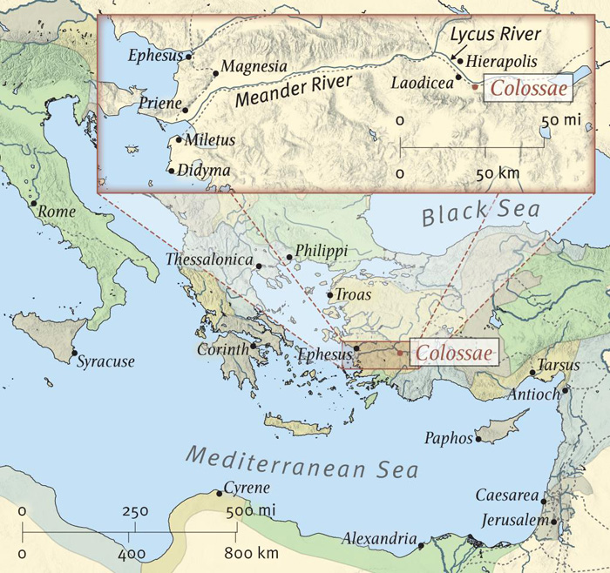

Slide 7
AUTHOR: PAUL (& TIMOTHY) IN PRISON
DATE: 60-62 AD
AUDIENCE: SAINTS & FAITHFUL BRETHREN AT COLOSSAE. CHURCH LIKELY STARTED BY EPAPHRAS
THEME: JESUS IS SUPREME AND ALL WE NEED FOR ETERNAL LIFE

Slide 8
PAUL’S CONCERNS
1:23 – not moved away from the hope of the gospel
2:4 – so no one will delude you through persuasive argument
2:8 – so no one takes you captive through philosophy and deception
2:16 – no one is to act as your judge
2:18 – let no one keep defrauding you
2:20-21 – don’t submit to man made decrees
2:23 – don’t be taken by the appearance of wisdom in self-made religion

Slide 9
COLOSSIAN HERESY
Ceremonialism. It held to strict rules about the kinds of permissible food and drink, religious festivals (2:16–17) and circumcision (2:11; 3:11).
Asceticism. “Do not handle! Do not taste! Do not touch!” (2:21; cf. 2:23).
Angel worship. See 2:18.
Depreciation of Christ. This is implied in Paul’s emphasis on the supremacy of Christ (1:15–20; 2:2–3:9).
Secret knowledge. The Gnostics boasted of this (see 2:18 and Paul’s emphasis in 2:2–3 on Christ, “in whom are hidden all the treasures of wisdom”).
Reliance on human wisdom and tradition. See 2:4,8.

