Slide 2
The Cave of Adullam

Slide 3
David departed from there and escaped to the cave of Adullam. And when his brothers and all his father's house heard it, they went down there to him. And everyone who was in distress, and everyone who was in debt, and everyone who was bitter in soul, gathered to him. And he became commander over them. And there were with him about four hundred men.
1 Samuel 22:1-2

Slide 4
And three of the thirty chief men went down and came about harvest time to David at the cave of Adullam, when a band of Philistines was encamped in the Valley of Rephaim. David was then in the stronghold, and the garrison of the Philistines was then at Bethlehem. And David said longingly, “Oh, that someone would give me water to drink from the well of Bethlehem that is by the gate!” Then the three mighty men broke through the camp of the Philistines…

Slide 5
…and drew water out of the well of Bethlehem that was by the gate and carried and brought it to David. But he would not drink of it. He poured it out to the Lord and said, “Far be it from me, O Lord, that I should do this. Shall I drink the blood of the men who went at the risk of their lives?” Therefore he would not drink it. These things the three mighty men did.
2 Samuel 23:13-17 (1 Chronicles 11:15-19)

Slide 6
Mentioned three times in referring to the hometown of a person (Adullamite) – Genesis 38:1, 12, 20
Mentioned once as one of the cities Joshua conquered – Joshua 12:14
Mentioned once as one of the cities in the allotment to Judah – Joshua 15:35
Mentioned once as one of the cities that King Rehoboam built up – 2 Chronicles 11:7
Mentioned once as one of the cities occupied by the remnant – Nehemiah 11:30
Mentioned once in prophecy about the upcoming destruction – Micah 1:15
What is Adullam?

Slide 8
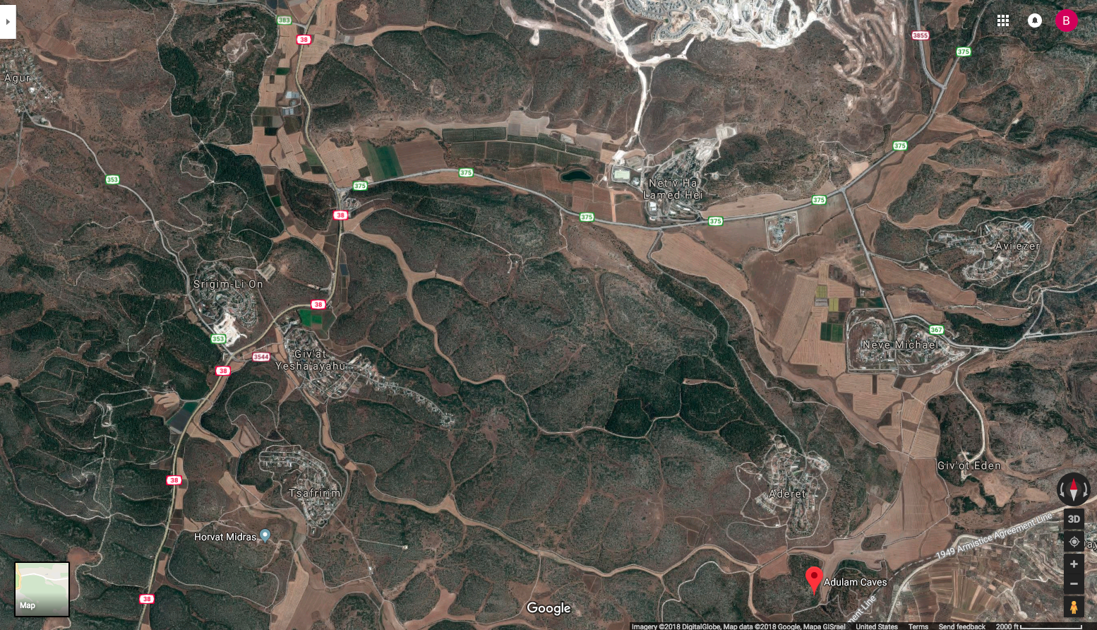

Slide 16
Why would David come to this place?

