Slide 2
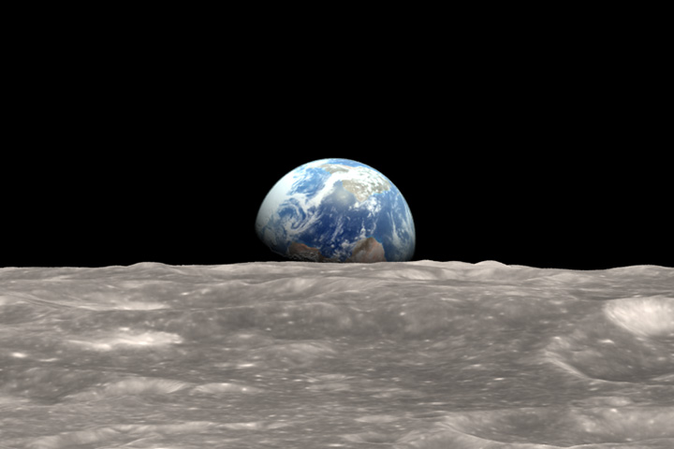
"In the beginning, God created the heavens and the earth."

Slide 3
LOOK AROUND

Slide 4
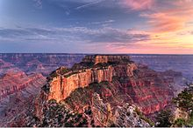
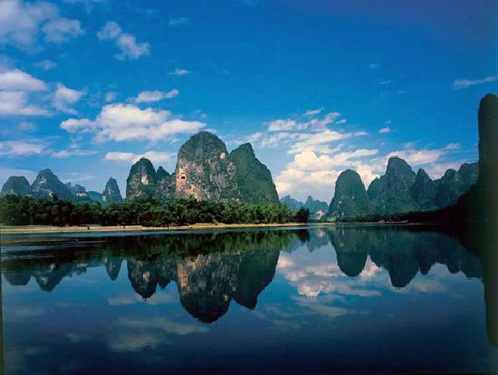
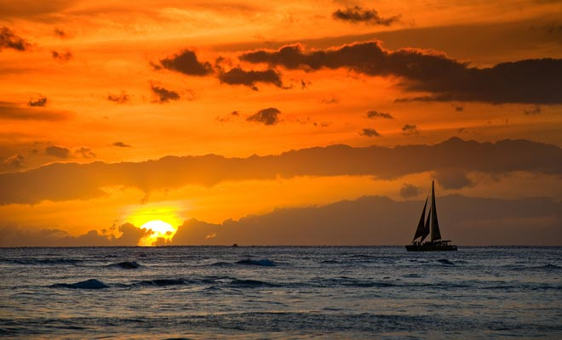
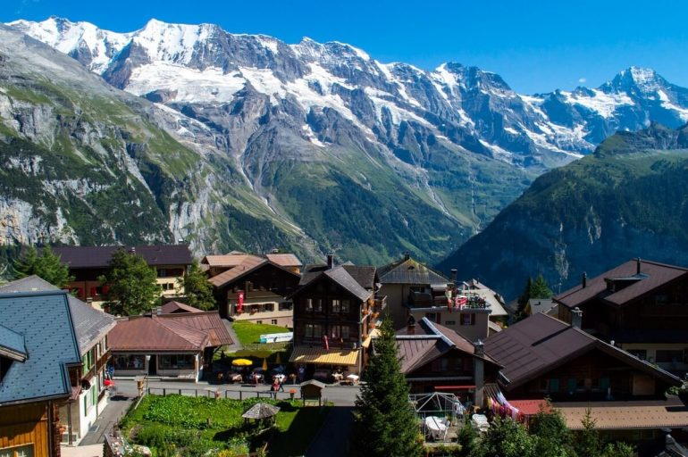

Slide 5
LOOK AROUND
LOOK INSIDE
LOOK TO HIS SON
IGNORANCE
SIN
PRIDE

