Slide 3
LESSONS FROM LEVITICUS
Sacrifice

Slide 4
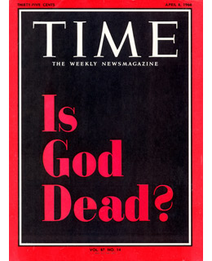
“Instead of churches preaching about people going to heaven when they die, they should preach about people helping each other in this life because that’s all we have”

Slide 5
LESSONS FROM LEVITICUS
Sacrifice
“giving up something for something you want more”

Slide 6
LESSONS FROM LEVITICUS
Sacrifice
Blood
Obedience

Slide 7
