Slide 2
Do not be conformed to this world
Romans 11:33-12:2
33 Oh, the depth of the riches both of the wisdom and knowledge of God! How unsearchable are His judgments and unfathomable His ways! 34 For WHO HAS KNOWN THE MIND OF THE LORD, OR WHO BECAME HIS COUNSELOR? 35 Or WHO HAS FIRST GIVEN TO HIM THAT IT MIGHT BE PAID BACK TO HIM AGAIN? 36 For from Him and through Him and to Him are all things. To Him be the glory forever. Amen.

Slide 3
Do not be conformed to this world
Romans 11:33-12:2
1 Therefore I urge you, brethren, by the mercies of God, to present your bodies a living and holy sacrifice, acceptable to God, which is your spiritual service of worship. 2 And do not be conformed to this world, but be transformed by the renewing of your mind, so that you may prove what the will of God is, that which is good and acceptable and perfect.

Slide 4
Do not be conformed to this world
Conformed –
suschematizio – soos-khay-mat-id-zo
To fashion alike, conform to the same pattern – Strong
To fashion or shape one thing like another – Vine

Slide 5
Do not be conformed to this world
World –
aion – ahee-ohn (not kosmos).
An age – Strong
An age, a period of time, marked in the NT usage by spiritual and moral characteristics. - Vine
1 John 2:17
17 The world is passing away, and also its lusts; but the one who does the will of God lives forever.

Slide 6
Do not be conformed to this world
Transformed –
metamorphoo – met-am-or-fo-o
To transform, change, transfigure – Strong
To change into another form – Vine

Slide 7
Do not be conformed to this world
J.B. Phillips translation -
“Don’t let the world around you squeeze you into its own mold”

Slide 8
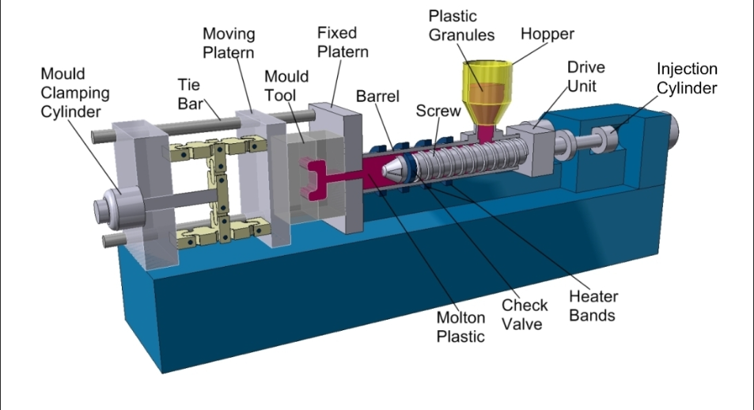

Slide 9
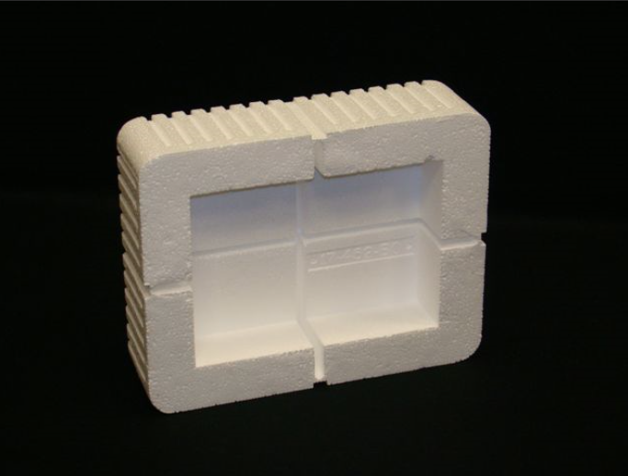

Slide 10
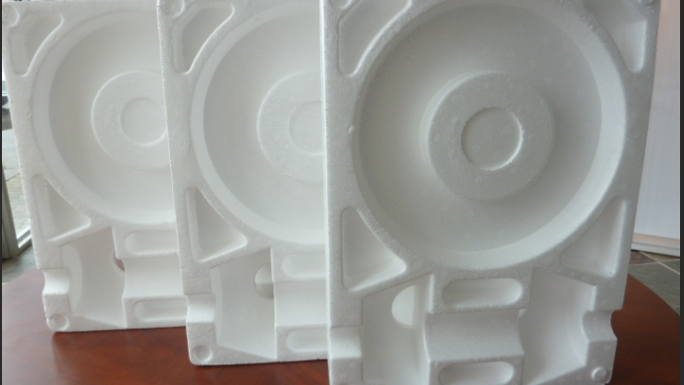

Slide 11
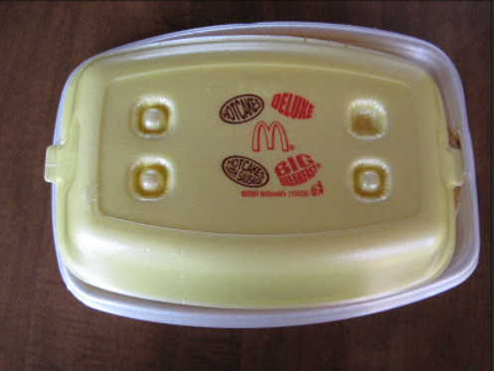

Slide 12
Do not be conformed to this world
We must be transformed morally
John 12:31
31 "Now judgment is upon this world; now the ruler of this world will be cast out.

Slide 13
Do not be conformed to this world
We must be transformed morally
John 14:30
30 "I will not speak much more with you, for the ruler of the world is coming, and he has nothing in Me;

Slide 14
Do not be conformed to this world
We must be transformed morally
Ephesians 2:1-2
1 And you were dead in your trespasses and sins, 2 in which you formerly walked according to the course of this world, according to the prince of the power of the air, of the spirit that is now working in the sons of disobedience.

Slide 15
Do not be conformed to this world
We must be transformed morally
1 John 2:15-16
15 Do not love the world nor the things in the world. If anyone loves the world, the love of the Father is not in him. 16 For all that is in the world, the lust of the flesh and the lust of the eyes and the boastful pride of life, is not from the Father, but is from the world.

Slide 16
Do not be conformed to this world
We must be transformed morally
1 Peter 1:14
14 As obedient children, do not be conformed to the former lusts which were yours in your ignorance,

Slide 17
Do not be conformed to this world
We must be transformed mentally
Romans 12:2
2 And do not be conformed to this world, but be transformed by the renewing of your mind, so that you may prove what the will of God is, that which is good and acceptable and perfect.

Slide 18
Do not be conformed to this world
We must be transformed mentally
Ephesians 4:22-23
22 that, in reference to your former manner of life, you lay aside the old self, which is being corrupted in accordance with the lusts of deceit, 23 and that you be renewed in the spirit of your mind,

Slide 19
Do not be conformed to this world
We must be transformed mentally
2 Peter 1:2-3
2 Grace and peace be multiplied to you in the knowledge of God and of Jesus our Lord; 3 seeing that His divine power has granted to us everything pertaining to life and godliness, through the true knowledge of Him who called us by His own glory and excellence.

Slide 20
Do not be conformed to this world
We must be transformed mentally
Ephesians 6:12
12 For our struggle is not against flesh and blood, but against the rulers, against the powers, against the world forces of this darkness, against the spiritual forces of wickedness in the heavenly places.

Slide 21
Do not be conformed to this world
We must be transformed motivationally
Romans 12:2
2 And do not be conformed to this world, but be transformed by the renewing of your mind, so that you may prove what the will of God is, that which is good and acceptable and perfect.

Slide 23
Do not be conformed to this world
We must be transformed motivationally
2 Corinthians 13:5
5 Test yourselves to see if you are in the faith; examine yourselves! Or do you not recognize this about yourselves, that Jesus Christ is in you — unless indeed you fail the test?

Slide 24
What must I do to be saved?
Hear the gospel
Romans 10:17
Believe in the Lord
John 8:24
Repent of your sins
Acts 3:19
Confess your belief
Acts 8:37
Be baptized for remission of sin
Mark 16:16

