Slide 2
Greatly rejoicing at the suffering of trials
1 Peter 1:6-7
6 In this you greatly rejoice, even though now for a little while, if necessary, you have been distressed by various trials, 7 so that the proof of your faith, being more precious than gold which is perishable, even though tested by fire, may be found to result in praise and glory and honor at the revelation of Jesus Christ;

Slide 3
Greatly rejoicing at the suffering of trials
peirasmos – trials
A putting to proof; by experiment of good, experience
of evil, solicitation, discipline or provocation,
by implication adversity.
20 verses in the NT.

Slide 4
Greatly rejoicing at the suffering of trials
1 Peter 4:12-13
12 Beloved, do not be surprised at the fiery ordeal among you, which comes upon you for your testing, as though some strange thing were happening to you; 13 but to the degree that you share the sufferings of Christ, keep on rejoicing, so that also at the revelation of His glory you may rejoice with exultation.

Slide 5
Greatly rejoicing at the suffering of trials
We, as Christians, should not have trials
or sufferings in our life if we are
pleasing to the Lord.
Correct?
How do we view the trials we face in this life?

Slide 6
Greatly rejoicing at the suffering of trials
The trials of Job and his suffering
Job 1:7-10
7 The LORD said to Satan, "From where do you come?" Then Satan answered the LORD and said, " From roaming about on the earth and walking around on it." 8 The LORD said to Satan, "Have you considered My servant Job? For there is no one like him on the earth, a blameless and upright man, fearing God and turning away from evil." 9 Then Satan answered the LORD, "Does Job fear God for nothing? 10 "Have You not made a hedge about him and his house and all that he has, on every side? You have blessed the work of his hands, and his possessions have increased in the land.

Slide 7
Greatly rejoicing at the suffering of trials
The trials of Job and his suffering
Job 1:20-22
20 Then Job arose and tore his robe and shaved his head, and he fell to the ground and worshiped. 21 He said,
"Naked I came from my mother's womb,
And naked I shall return there.
The LORD gave and the LORD has taken away.
Blessed be the name of the LORD."
22 Through all this Job did not sin nor did he blame God.

Slide 8
Greatly rejoicing at the suffering of trials
The trials of Job and his suffering
Job 2:2-3
2 The LORD said to Satan, "Where have you come from?" Then Satan answered the LORD and said, "From roaming about on the earth and walking around on it." 3 The LORD said to Satan, "Have you considered My servant Job? For there is no one like him on the earth, a blameless and upright man fearing God and turning away from evil. And he still holds fast his integrity, although you incited Me against him to ruin him without cause."

Slide 9
Greatly rejoicing at the suffering of trials
The trials of Job and his suffering
Job 2:7-10
7 Then Satan went out from the presence of the LORD and smote Job with sore boils from the sole of his foot to the crown of his head. 8 And he took a potsherd to scrape himself while he was sitting among the ashes. 9 Then his wife said to him, "Do you still hold fast your integrity? Curse God and die!" 10 But he said to her, "You speak as one of the foolish women speaks. Shall we indeed accept good from God and not accept adversity?" In all this Job did not sin with his lips.

Slide 10
Greatly rejoicing at the suffering of trials
The trials of Job and his suffering
Job 42:12-13
12 The LORD blessed the latter days of Job more than his beginning; and he had 14,000 sheep and 6,000 camels and 1,000 yoke of oxen and 1,000 female donkeys. 13 He had seven sons and three daughters.

Slide 11
Greatly rejoicing at the suffering of trials
The trials of Jesus and His suffering
Luke 22:39-44
39 And He came out and proceeded as was His custom to the Mount of Olives; and the disciples also followed Him. 40 When He arrived at the place, He said to them, "Pray that you may not enter into temptation." 41 And He withdrew from them about a stone's throw, and He knelt down and began to pray, 42 saying, "Father, if You are willing, remove this cup from Me; yet not My will, but Yours be done." 43 Now an angel from heaven appeared to Him, strengthening Him. 44 And being in agony He was praying very fervently; and His sweat became like drops of blood, falling down upon the ground.

Slide 12
Greatly rejoicing at the suffering of trials
The trials of Jesus and His suffering
Hebrews 5:7
7 In the days of His flesh, He offered up both prayers and supplications with loud crying and tears to the One able to save Him from death, and He was heard because of His piety.

Slide 13
Greatly rejoicing at the suffering of trials
The trials of Jesus and His suffering
Hebrews 12:2
2 fixing our eyes on Jesus, the author and perfecter of faith, who for the joy set before Him endured the cross, despising the shame, and has sat down at the right hand of the throne of God.

Slide 14
Greatly rejoicing at the suffering of trials
The trials of Paul and his suffering
Acts 20:18-19
18 And when they had come to him, he said to them, "You yourselves know, from the first day that I set foot in Asia, how I was with you the whole time, 19 serving the Lord with all humility and with tears and with trials which came upon me through the plots of the Jews;

Slide 15
Greatly rejoicing at the suffering of trials
The trials of Paul and his suffering
2 Corinthians 11:24-27
24 Five times I received from the Jews thirty-nine lashes. 25 Three times I was beaten with rods, once I was stoned, three times I was shipwrecked, a night and a day I have spent in the deep. 26 I have been on frequent journeys, in dangers from rivers, dangers from robbers, dangers from my countrymen, dangers from the Gentiles, dangers in the city, dangers in the wilderness, dangers on the sea, dangers among false brethren; 27 I have been in labor and hardship, through many sleepless nights, in hunger and thirst, often without food, in cold and exposure.

Slide 16
Greatly rejoicing at the suffering of trials
The trials of Paul and his suffering
Acts 27:18-20
18 The next day as we were being violently storm-tossed, they began to jettison the cargo; 19 and on the third day they threw the ship's tackle overboard with their own hands. 20 Since neither sun nor stars appeared for many days, and no small storm was assailing us, from then on all hope of our being saved was gradually abandoned.

Slide 17
Greatly rejoicing at the suffering of trials
The trials of Paul and his suffering
Philippians 1:23-24
23 But I am hard-pressed from both directions, having the desire to depart and be with Christ, for that is very much better; 24 yet to remain on in the flesh is more necessary for your sake.

Slide 18
Greatly rejoicing at the suffering of trials
What trials are we suffering?
Hebrews 12:4-11
7 It is for discipline that you endure; God deals with you as with sons; for what son is there whom his father does not discipline? 8 But if you are without discipline, of which all have become partakers, then you are illegitimate children and not sons. 9 Furthermore, we had earthly fathers to discipline us, and we respected them; shall we not much rather be subject to the Father of spirits, and live? 10 For they disciplined us for a short time as seemed best to them, but He disciplines us for our good, so that we may share His holiness. 11 All discipline for the moment seems not to be joyful, but sorrowful; yet to those who have been trained by it, afterwards it yields the peaceful fruit of righteousness.

Slide 19
Greatly rejoicing at the suffering of trials
What trials are we suffering?
Hebrews 10:32-35
32 But remember the former days, when, after being enlightened, you endured a great conflict of sufferings, 33 partly by being made a public spectacle through reproaches and tribulations, and partly by becoming sharers with those who were so treated. 34 For you showed sympathy to the prisoners and accepted joyfully the seizure of your property, knowing that you have for yourselves a better possession and a lasting one. 35 Therefore, do not throw away your confidence, which has a great reward.

Slide 20
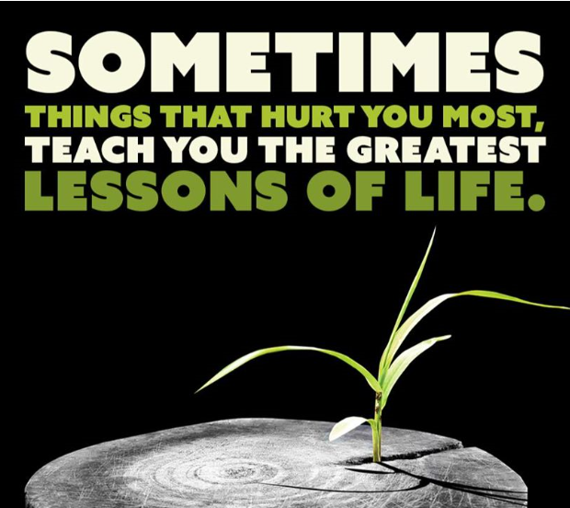

Slide 21
Greatly rejoicing at the suffering of trials
Elijah prayed for and suffered with Israel
James 5:17-18
17 Elijah was a man with a nature like ours, and he prayed earnestly that it would not rain, and it did not rain on the earth for three years and six months. 18 Then he prayed again, and the sky poured rain and the earth produced its fruit.

Slide 22
Greatly rejoicing at the suffering of trials
The trials of our brethren need to become our trials
1 Corinthians 12:26
26 And if one member suffers, all the members suffer with it; if one member is honored, all the members rejoice with it.

Slide 23
Greatly rejoicing at the suffering of trials
Who knows if your trials are to help others?
Esther 4:13-14
13 Then Mordecai told them to reply to Esther, "Do not imagine that you in the king's palace can escape any more than all the Jews. 14 "For if you remain silent at this time, relief and deliverance will arise for the Jews from another place and you and your father's house will perish. And who knows whether you have not attained royalty for such a time as this?"

Slide 24
What must I do to be saved?
Hear the gospel
Romans 10:17
Believe in the Lord
John 8:24
Repent of your sins
Acts 3:19
Confess your belief
Acts 8:37
Be baptized for remission of sin
Mark 16:16

