Slide 2
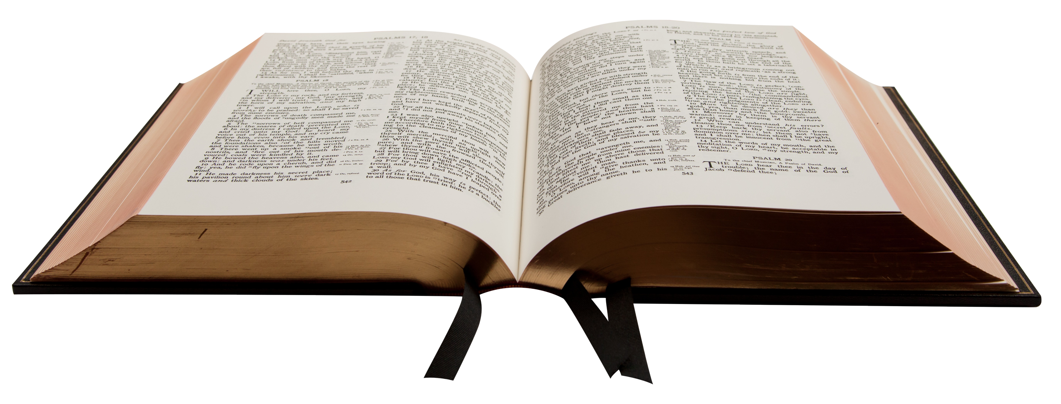
“forgive us our debts, as we forgive our debtors”
Matt 6.12

Slide 3
“forgive us our debts”
Forsake us
Forgive us

Slide 4
“as we forgive our debtors”
Releases me from my past
Restores relationships

