Slide 2
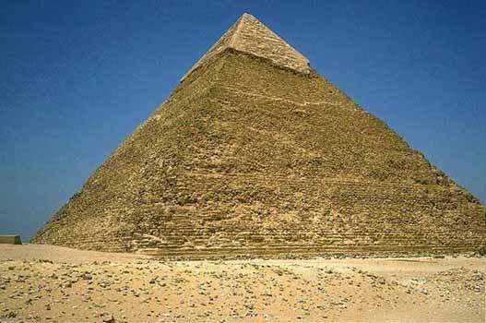
X

Slide 3
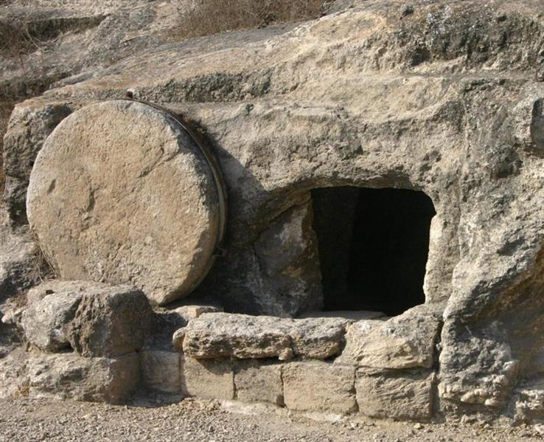

Slide 4
RAISED WITH JESUS

Slide 5
RAISED WITH JESUS
Provable
Fulfilled prophecy
To be preached

Slide 6
RAISED WITH JESUS
Victory over death
Vindication of the righteous
Value of hope

