Slide 2
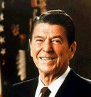
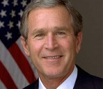
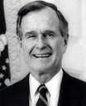

Slide 4
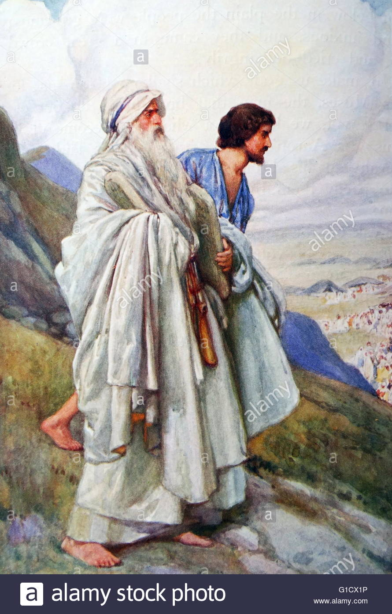
UPBRINGING
EXPERIENCES
CALLING

Slide 5
PURPOSE
JOSH 1.2-4
PROMISE
JOSH 1.5
PRECEPTS
JOSH 1.7-8

Slide 6
PURPOSE
MATT 28.18-20
PROMISE
MATT 28.20
PRECEPTS
1 PETER 1.23

