Slide 2
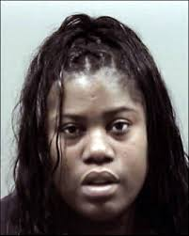
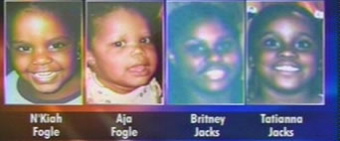

Slide 3
Explaining demon possession
Sickness
Satan
Symbolic

Slide 4
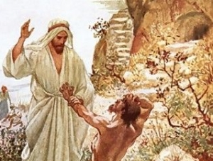
THE OUTSIDE

Slide 5
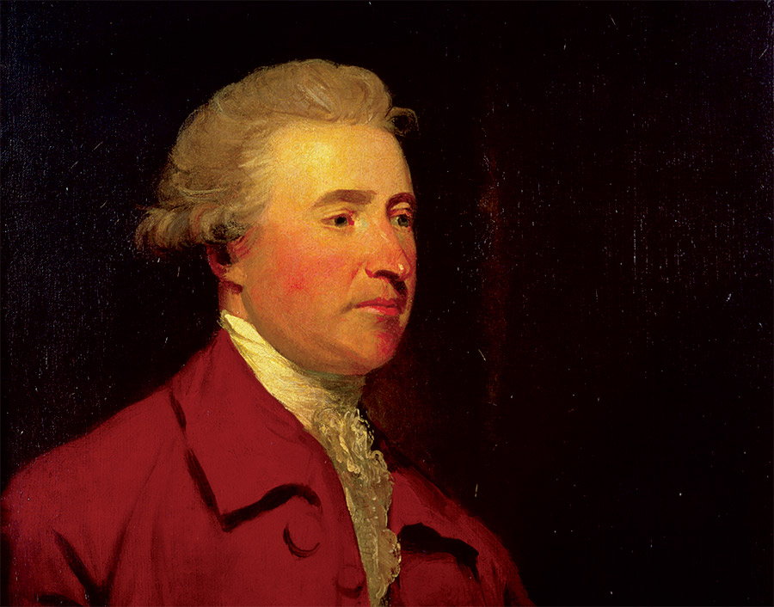
“Society can not exist unless a controlling power upon will and appetite be placed somewhere, and the less of it there is within, the more there must be without.”

Slide 6
THE OUTSIDE
THE INSIDE
THE UPSIDE

