Slide 2
LOST IN THE CREDITS
EBED-MELECH
Jeremiah 38-39
EXTRAORDINARY LESSONS FROM
ORDINARY PEOPLE

Slide 3
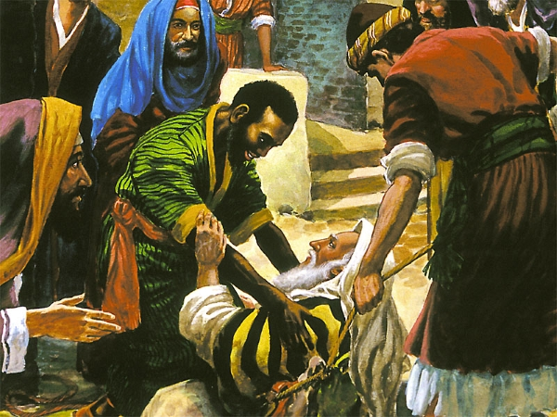
EBED-MELECH
Character (Jer 38.7)
Courage (Jer 38.8-9)
Conviction (Jer 38.10)

Slide 4
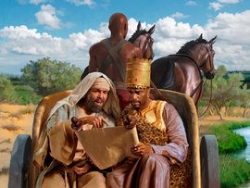
ETHIOPIAN EUNUCH
Character (Acts 8.27)
Courage (Acts 8.31)
Conviction (Acts 8.36)

