Slide 2
LOST IN THE CREDITS
LEAH
GEN 29-30
EXTRAORDINARY LESSONS FROM
ORDINARY PEOPLE

Slide 3
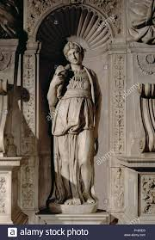
LEAH’S DESIRES
To be Loved (Gen 29.31-32)
To be Liked (Gen 29.34)
To be Lived with (Gen 30.19-20 )

Slide 4
IMPERFECT MARRIAGE
She faced her situation
She didn’t punish her husband
She filled herself with the Lord

