Slide 2
LOST IN THE CREDITS
NIMROD
GEN 10
EXTRAORDINARY LESSONS FROM
ORDINARY PEOPLE

Slide 3
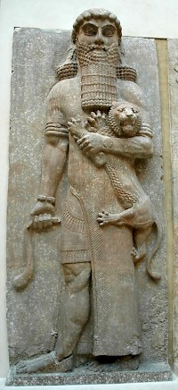
NIMROD
Mighty Ruler (Gen 10.10)
Mighty Rebel (Gen 10.9)
Mighty Race (Gen 11.1-9)

Slide 4
DESCENDANTS OF NIMROD
Sinfully disobedient (Gen 11.2)
Selfishly dependent (Gen 11.3)
Spiritually distorted (Gen 11.4)

