Slide 2
LOST IN THE CREDITS
OBADIAH
1 Kings 18
EXTRAORDINARY LESSONS FROM
ORDINARY PEOPLE

Slide 3
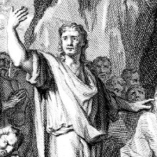
OBADIAH
Charge (1 Kings 18.3)
Conviction (1 Kinga 18.3)
Courage (1 Kings 18.4)

