Slide 2
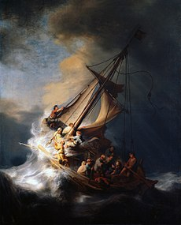
SOURCE OF STORMS
OUR DISOBEDIENCE
OTHERS DISOBEDIENCE
OUR OBEDIENCE

Slide 3
CALMING THE STORMS OF LIFE
CORRECT US
CONSTRUCT US
CONNECT US

