Slide 2
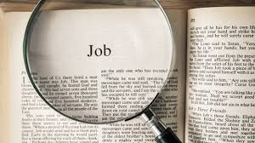
IN PRAISE OF JOB
Victor Hugo- "Tomorrow, if all literature was to be destroyed and it was left to me to retain one work only, I should save Job."
Alfred Lord Tennyson- "the greatest poem, whether of ancient or modern literature."
Daniel Webster- “The Book of Job taken as a mere work of literary genius, is one of the most wonderful productions of any age or of any language”

Slide 3
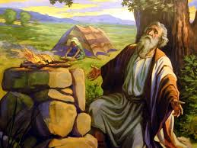
JOB
HIS FAITH
HIS FAMILY
HIS FORTUNE

Slide 4
LOST IN THE CREDITS
MRS JOB
JOB 2
EXTRAORDINARY LESSONS FROM
ORDINARY PEOPLE

Slide 5
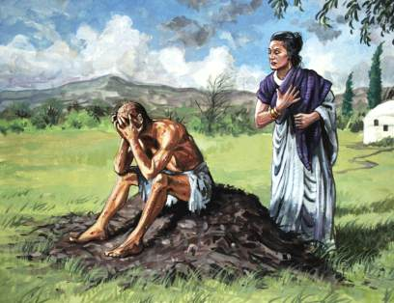
MISTAKES OF MRS JOB
LACK OF PREPARATION

Slide 6
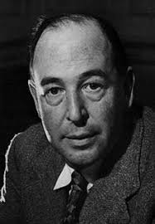
“Not that I am (I think) in much danger of ceasing to believe in God. The real danger is of coming to believe such dreadful things about Him. The conclusion I dread is not ‘So there’s no God after all,’ but ‘So this is what God’s really like. Deceive yourself no longer.”
C.S. Lewis

Slide 7
MISTAKES OF MRS JOB
LACK OF PREPARATION
LACK OF PERSPECTIVE
LACK OF UNDERSTANDING ABOUT PERMANENCE

