Slide 2
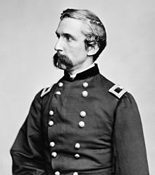
COL. JOSHUA CHAMBERLAIN
The LION OF ROUND TOP

Slide 3
LOST IN THE CREDITS
SHAMGAR
JUDGES 3
EXTRAORDINARY LESSONS FROM
ORDINARY PEOPLE

Slide 4
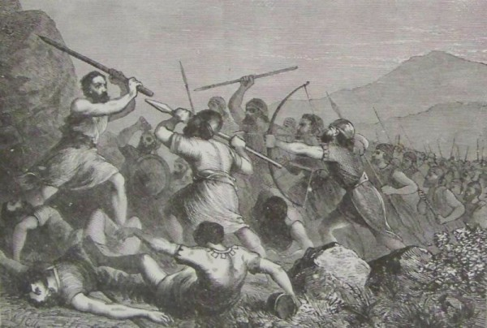
TIME OF SHAMGAR
Time of social weakness
Time of physical weakness
Time of spiritual weakness

Slide 5
SHAMGAR
FARMER
FIGHTER
FAITHFUL

Slide 6
LESSONS FROM SHAMGAR
Start where you are at
Use what you have
Do what you can

Slide 7
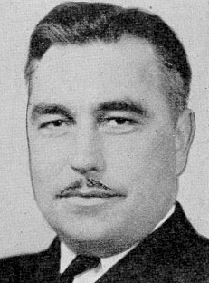
Cdr. Ernest E. “Cherokee” Evans

