Slide 2
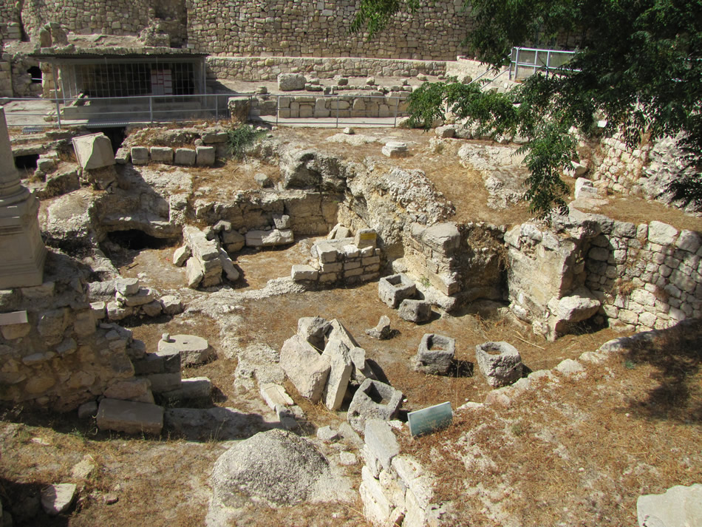

Slide 4
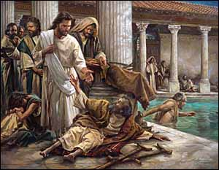
STAND UP FOR JESUS
John 5.31-47
JOHN THE BAPTIST
HIS WORKS
SCRIPTURE

Slide 5
"What I feared was that it might affect you. It is a beautiful story. Let it remain so. We don't have to do anything about it, do we?"

