Slide 2
Identifying truth decay

Slide 3
Identifying truth decay
The question of objective truth is not new
the Jews struggled identify objective truth because they were were rooted in the traditions of something subjective
John 8:39-47

Slide 4
Identifying truth decay
When Jesus found himself before Pilate, his curiosity for truth was a Roman philosophical question raised by Greek philosophers that continued for hundreds of years
John 18:33-38
Then, how can we identify truth decay today?
Be on the lookout for teachers who deny the idea of truth
Be watchful for those that preach tolerance over objective truth

Slide 5
How does one stop truth decay?
Deuteronomy 6:1-9
6 “Now this is the commandment, and these are the statutes and judgments which the LORD your God has commanded to teach you, that you may observe them in the land which you are crossing over to possess, ² that you may fear the LORD your God, to keep all His statutes and His commandments which I command you, you and your son and your grandson, all the days of your life, and that your days may be prolonged.

Slide 6
How does one stop truth decay?
Fear God
6 “Now this is the commandment, and these are the statutes and judgments which the LORD your God has commanded to teach you, that you may observe them in the land which you are crossing over to possess,
² that you may fear the LORD your God,
to keep all His statutes and His commandments which I command you, you and your son and your grandson, all the days of your life, and that your days may be prolonged.

Slide 7
How does one stop truth decay?
Fear God
Keep his statutes
6 “Now this is the commandment, and these are the statutes and judgments which the LORD your God has commanded to teach you, that you may observe them in the land which you are crossing over to possess, ² that you may fear the LORD your God,
to keep all His statutes and His commandments which I command you,
you and your son and your grandson, all the days of your life, and that your days may be prolonged.

Slide 8
How does one stop truth decay?
Fear God
Keep his statutes
Teach the bible to your children and to others
⁶ “And these words which I command you today shall be in your heart.
⁷ You shall teach them diligently to your children,
and shall talk of them when you sit in your house, when you walk by the way, when you lie down, and when you rise up.

Slide 9
How does one stop truth decay?
Fear God
Keep his statutes
Teach the bible to your children and to others
Repeat daily
⁶ “And these words which I command you today shall be in your heart. ⁷ You shall teach them diligently to your children, and shall talk of them when you sit in your house, when you walk by the way, when you lie down, and when you rise up. ⁸ You shall bind them as a sign on your hand, and they shall be as frontlets between your eyes. ⁹ You shall write them on the doorposts of your house and on your gates.

Slide 10
How does one stop truth decay?
These actions alone are difficult to maintain without true love
⁴ “Hear, O Israel: The LORD our God, the LORD is one!
⁵ You shall love the LORD your God with all your heart, with all your soul, and with all your strength.
⁶ “And these words which I command you today shall be in your heart

Slide 11
How does one stop truth decay?
These actions alone are difficult to maintain without true love
If we are not watchful and proactive, our children or grandchildren may not live to see active truth in the church

Slide 12
What are you doing to pursue truth?
John 18:1-12
14 “Let not your heart be troubled; you believe in God, believe also in Me. ² In My Father’s house are many mansions; if it were not so, would have told you. I go to prepare a place for you. ³ And if I go and prepare a place for you, I will come again and receive you to Myself; that where I am, there you may be also. ⁴ And where I go you know, and the way you know.”
⁵ Thomas said to Him, “Lord, we do not know where You are going, and how can we know the way?”
⁶ Jesus said to him,
“I am the way, the truth, and the life. No one comes to the Father except through Me.

Slide 13
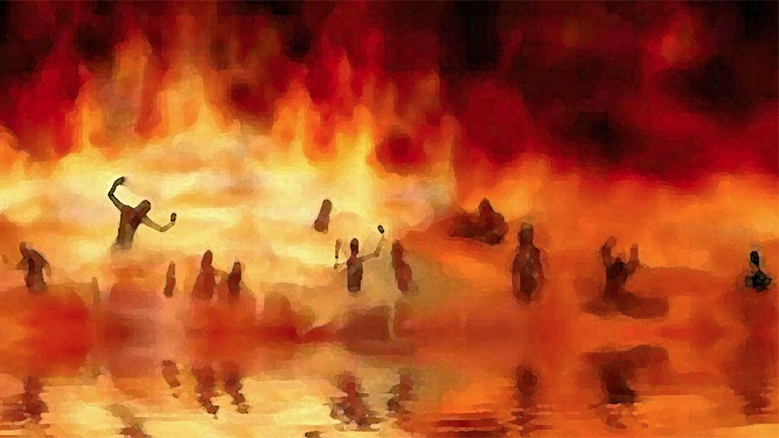
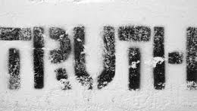
What are you doing to pursue truth?
Do you know “the truth”?
Have you heard his message?
Do you fear “the truth”?
If you’ve heard the gospel call and you’ve not responded, you owe it to those who love you to answer these questions, before it is too late and truth has already been replaced by worldly pleasures…

