Slide 2
LOST IN THE CREDITS
BARABBAS
MATT 27; MARK 15; LUKE 23; JOHN 18; ACTS 3
EXTRAORDINARY LESSONS FROM
ORDINARY PEOPLE

Slide 3
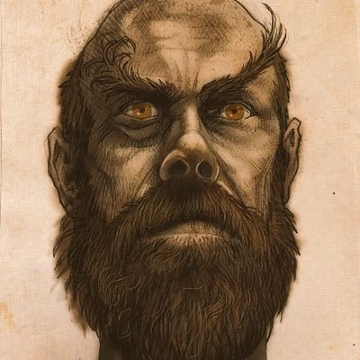
BARABBAS
John 18.40 he is called a “robber”
Matt 27.16 “notorious prisoner”
Mark 15.7 “had committed murder”
Luke 23.19 involved in “a certain rebellion made in the city, and for murder.”
Acts 3.14 Peter described Barabbas as a “murderer”

Slide 4
BARNA POLL
“Do you accepted the authority of Jesus Christ in all religious matters.”
RESULT- 80% said yes
“Is a man forbidden from divorcing his wife except for the cause of fornication as taught by Jesus in Matt 19?”
RESULT- 24% said yes

Slide 5
OFFENSIVE JESUS
WHERE HE WAS FROM
WHAT HE SAID
WHAT HE DEMANDS

Slide 6
V. Gene Robinson- “God loves you the way you are and God doesn’t want you to change. God doesn’t want you to be cured or healed, because there’s nothing to be healed from.”
James Banks- “Have fun but give your life to God. God doesn’t want you to change your character. He just wants your character working for Him.”

