Slide 2
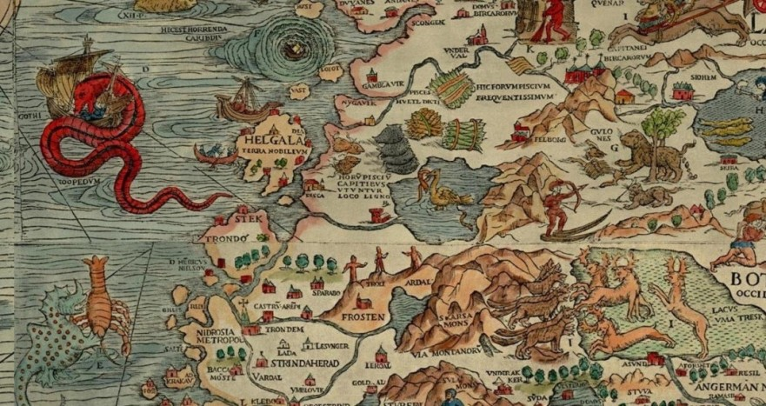
Beyond this line there be dragons

Slide 3
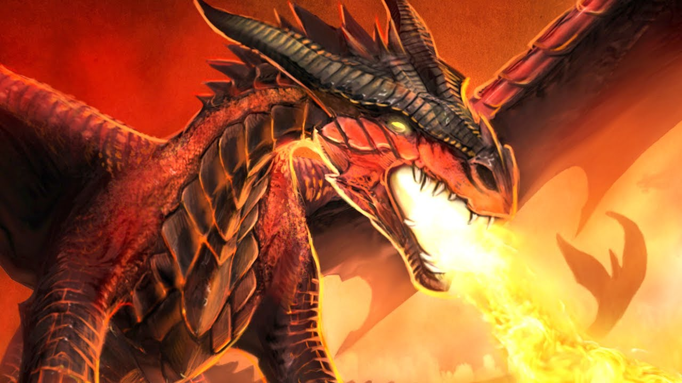
DRAGON PROOFING OUR CHILDREN

Slide 4
WHY CHILDREN SHOULD OBEY PARENTS
RIGHT
REVELATION
REWARD
EPHESIANS 6.1-3

Slide 5
INSTRUCTIONS TO PARENTS
DON’T PROVOKE
DON’T NEGLECT
EPHESIANS 6.4

Slide 6
MODERN IDOLATRY
BACCHUS
VENUS
DIANA
MARS
THE MUSES

Slide 7
SIX WAYS TO RUIN YOUR CHILD
Be their lawyer
Be their banker
Be their insurance company
Be their agent
Be their mechanic
Be their doormat

