Slide 2
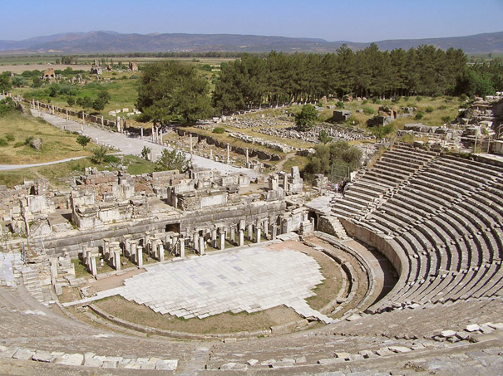

Slide 3
H U P O K R I T E S

Slide 4
HYPOCRITES
“Why should I never want to be a Christian; they’re nothing but a bunch of hypocrites.”
“I am not going to have anything to do with church because it is full of hypocrites.”

Slide 5
THREE QUESTIONS
How does the Lord define hypocrisy?
Are there hypocrites in the church?
Are you a hypocrite?

Slide 6
HYPOCRISY IS…
IDOLATRY
Charitable deeds
Public prayers
Fasting

Slide 7
HYPOCRISY IS…
IDOLATRY
INSINCERE
Judge others
Law bender
Wickedness

Slide 8
HYPOCRISY IS…
IDOLATRY
INSINCERE
INFECTIOUS

Slide 9
HYPOCRITES in the church
“It's nice to know that God has rounded up all the hypocrites and put them in church buildings, at least on Sunday mornings, so that all the people in the world who have pristine motives and clear consciences don't have to put up with them.”

Slide 10
ARE YOU A HYPOCRITE?

