Slide 2
LOST IN THE CREDITS
PILATE
MATT 27; MARK 15; LUKE 23; JOHN 18-19
EXTRAORDINARY LESSONS FROM
ORDINARY PEOPLE

Slide 3
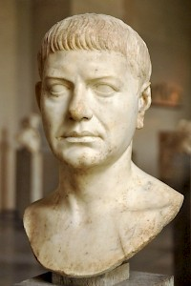
PILATE MISTAKES
ROMAN STANDARDS
TEMPLE FUNDS
GOLDEN SHIELDS

