Slide 1
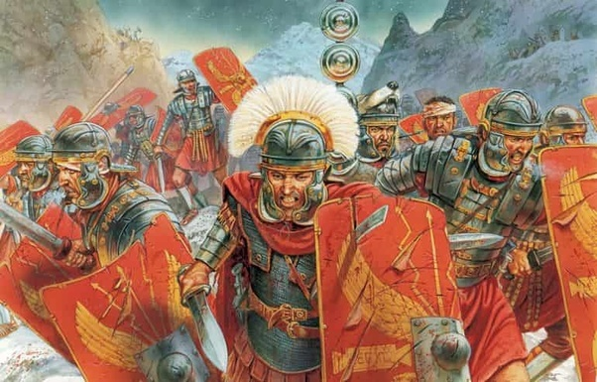
Ready to Fight!

Slide 2
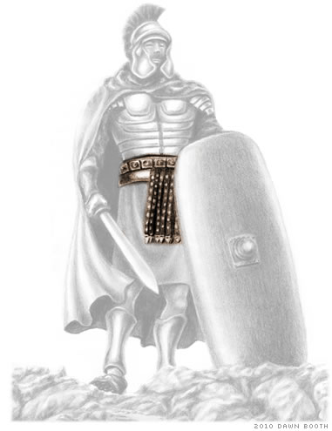
The Belt of Truth

Slide 3
The Belt of Truth
The belt holds everything together

Slide 4
The Belt of Truth
The belt holds everything together
No belt, no sword!

Slide 5
The Belt of Truth
The belt holds everything together
No belt, no sword!
The belt provides protection

Slide 6
The Belt of Truth
2 Timothy 4:3-4
For the time is coming when people will not endure sound teaching, but having itching ears they will accumulate for themselves teachers to suit their own passions, and will turn away from listening to the truth and wander off into myths.

Slide 7
The Belt of Truth
2 Timothy 4:3-4
Proverbs 23:23
Buy truth, and do not sell it…

Slide 8
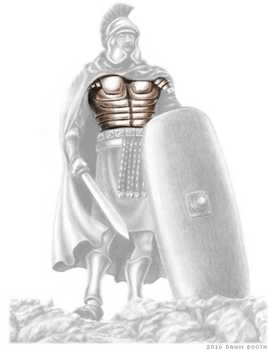
The Breastplate of Righteousness

Slide 9
The Breastplate of Righteousness
The breastplate protects the vital organs

Slide 10
The Breastplate of Righteousness
The breastplate protects the vital organs
Proverbs 11:4
Riches do not profit in the day of wrath, but righteousness delivers from death

Slide 11
The Breastplate of Righteousness
The breastplate protects the vital organs
Proverbs 11:4
Proverbs 10:16
The wages of the righteous is life, the income of the wicked, punishment.

Slide 12
The Breastplate of Righteousness
The breastplate protects the vital organs
Proverbs 11:4
Proverbs 10:16
Deuteronomy 6:25
And it will be righteousness for us , if we are careful to do all this commandment before the Lord our God, as He has commanded us.

Slide 13
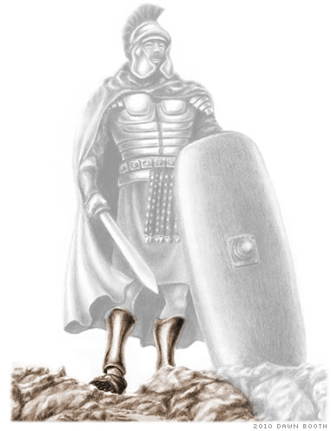
Shoes of Readiness/Gospel of Peace

Slide 14
Shoes of Readiness/Gospel of Peace
Shoes protect our feet

Slide 15
Shoes of Readiness/Gospel of Peace
Shoes protect our feet
Shoes allow us to stand firm

Slide 16
Shoes of Readiness/Gospel of Peace
Shoes protect our feet
Shoes allow us to stand firm
2 Thessalonians 2:15
…stand firm and hold to the traditions that you were taught by us, either by our spoken word or by our letter.

Slide 17
Shoes of Readiness/Gospel of Peace
Shoes on = ready for action

Slide 18
Shoes of Readiness/Gospel of Peace
Shoes on = ready for action
Romans 10:14-16
How then will they call on Him in whom they have not believed? And how are they to believe in Him of whom they have never heard? And how are they supposed to hear without someone preaching? And how are they to preach unless they are sent? As it is written, “How beautiful are the feet of those who preach the good news!”

Slide 19
Shoes of Readiness/Gospel of Peace
Shoes on = ready for action
Romans 10:14-16
2 Timothy 4:2
Preach the word; be ready in season and out of season…

Slide 20
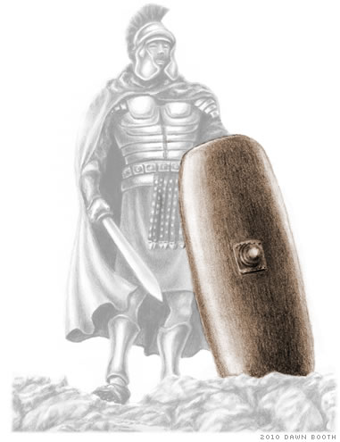
The Shield of Faith

Slide 21
The Shield of Faith
A shield can protect the whole body.

Slide 22
The Shield of Faith
A shield can protect the whole body
The shield is the first line of defense

Slide 23
The Shield of Faith
A shield can protect the whole body.
The shield is the first line of defense
The stronger the faith, the stronger the shield!

Slide 24
The Shield of Faith
How do we improve our faith?
Hearing the word
Romans 10:17
So faith comes from hearing, and hearing through the word of Christ.

Slide 25
The Shield of Faith
How do we improve our faith?
Our attitude towards trials
James 1:2-3
Count it all joy, my brothers, when you meet various trials, for you know that the testing of you faith produces steadfastness.

Slide 26
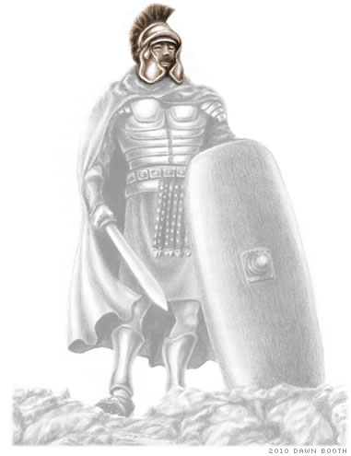
The Helmet of Salvation
The helmet protects the head

Slide 27
The Helmet of Salvation
The helmet protects the head
Our focus on our salvation will help prioritize our thoughts and actions

Slide 28
The Helmet of Salvation
The helmet protects the head
Our focus on our salvation will help prioritize our thoughts and actions
Philippians 2:12
Therefore, my beloved, as you have always obeyed, so now, not only as in my presence but much more in my absence, work out your own salvation with fear and trembling.

Slide 29
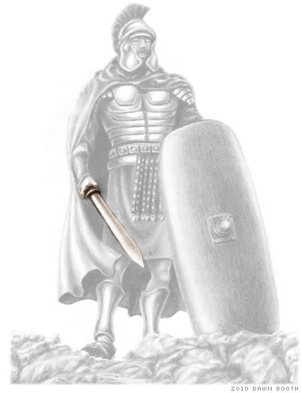
The Sword of the Spirit
The sword is a defensive and offensive weapon

Slide 30
The Sword of the Spirit
The sword is a defensive and offensive weapon
Hebrews 4:12
For the word of God is living and active, sharper than any two-edge sword, piercing the division of the soul and of the spirit, of joints and of marrow, and discerning the thoughts and intentions of the heart.

Slide 31
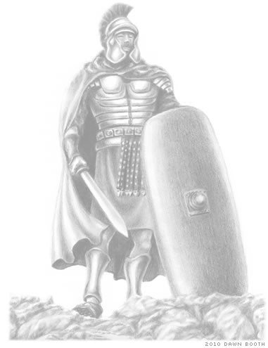
Prayer and Supplication
Ephesians 6:18
…praying at all times in the spirit, with all prayer and supplication. To that end, keep alert with all perseverance.

Slide 32
Prayer and Supplication
Ephesians 6:18
…praying at all times in the spirit, with all prayer and supplication. To that end, keep alert with all perseverance.
Prayer keeps us connected to our general!

Slide 33
Considerations

Slide 34
Considerations
Are you defenseless?

Slide 35
Considerations
Are you defenseless?
Do you have a “chink in your armor?”

