Slide 1
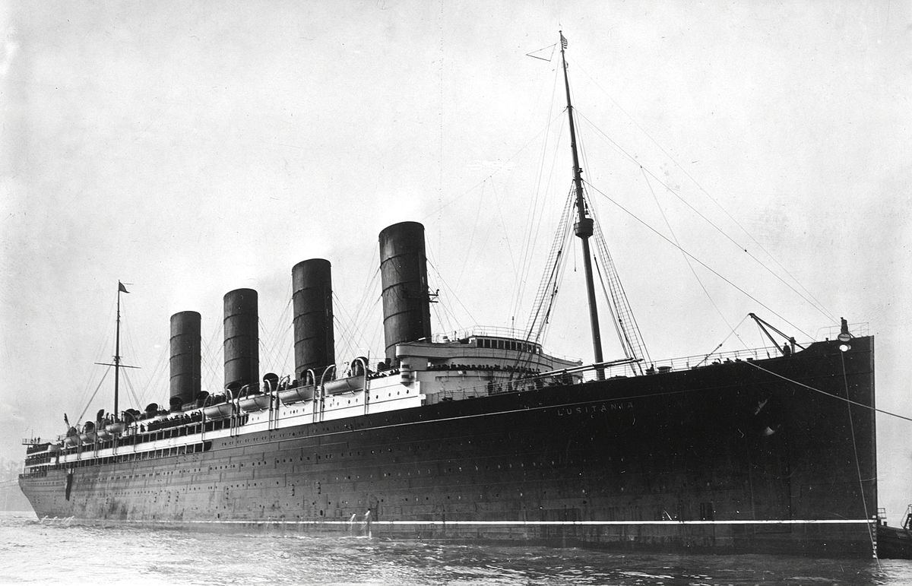

Slide 2
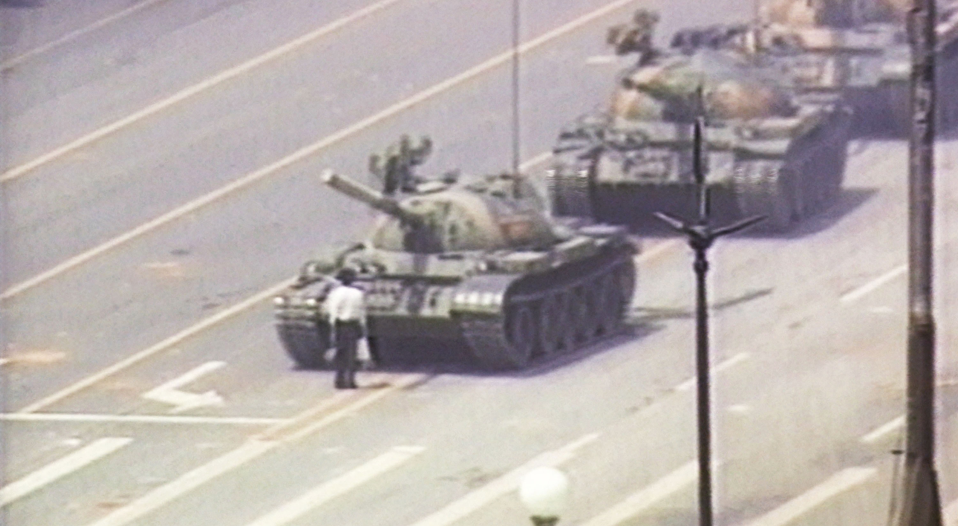

Slide 3
Remembrance
Why we should remember the past and what to do

Slide 4
Remembrance
How do we escape complacency?
We need to remember and keep it fresh on our minds.
How do we remember?
Don’t settle for complacency. Zeph. 1:12
“It will come about at that time that I will search Jerusalem with lamps, and I will punish the men who are stagnant in spirit, who say in their hearts, ‘The LORD will not do good or evil!’”
Look to the future…
“Whoever forgets one’s past is doomed to repeat it.” –George Santayana
Don’t forget the past entirely, but rather move on from such and use it as a reference as for what not to do.
Isaiah 43:18-19: “Remember not the former things, nor consider the things of old. Behold, I am doing a new thing; now it springs forth, do you not perceive it? I will make a way in the wilderness and rivers in the desert.”
Follow commands zealously…
Revelations 3:15-16: “I know your deeds, that you are neither cold nor hot. I wish that you were either one or the other! So, because you are lukewarm – neither hot nor cold – I am about to spit you out of my mouth.”

