Slide 2
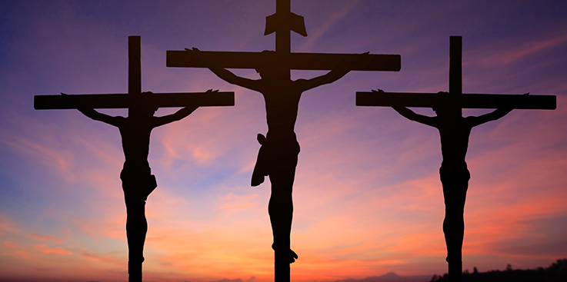

Slide 3
LESSONS FROM THE THEIF
WORTH OF A MAN
EQUALITY OF THE SAVED
GRACE OF GOD
THE PERIOD
THE PERSON
THE PETITION

