Slide 2
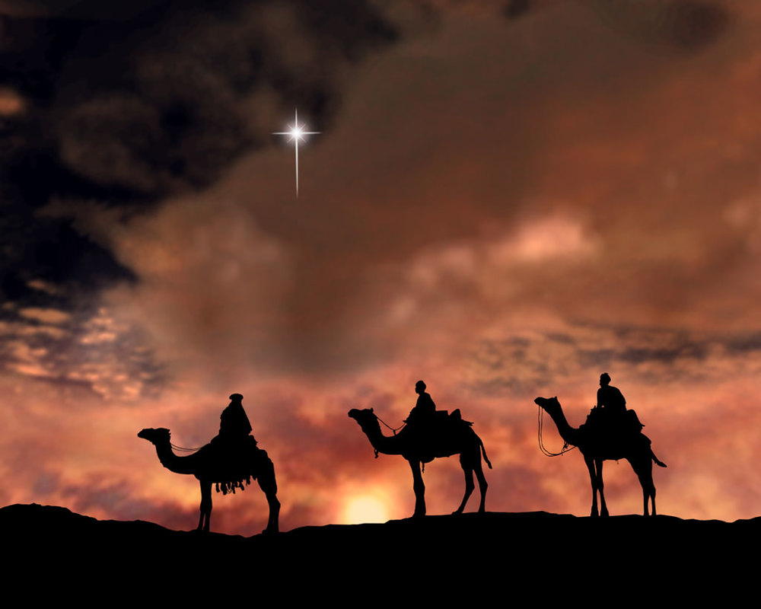

Slide 3
LOST IN THE CREDITS
THREE WISE MEN AND A BABY
ISA 7, 9; MIC 5, LUKE 2
EXTRAORDINARY LESSONS FROM
ORDINARY PEOPLE

Slide 4
3 WISE MEN AND A BABY
ISAIAH
MICAH

Slide 5
BOOK OF MORMON
“And behold, he shall be born of Mary, at Jerusalem which is the land of our forefathers, she being virgin, a precious and chosen vessel, who shall be overshadowed and conceive by the power of the Holy Ghost, and bring forth a son, yea, even the Son of God.”
Alma 7.10

Slide 6
3 WISE MEN AND A BABY
ISAIAH
MICAH
SIMEON

