Slide 2
“To think of having to give an account of all the souls in the congregation over which he rules is the most serious thought one could have. No greater charge has ever been given to any man. What a tremendous responsibility. Little wonder that God wanted the strongest men in the church to be the overseers of His flock”
(H.E. Phillips, Scriptural Elders and Deacons, p. 211)

Slide 3
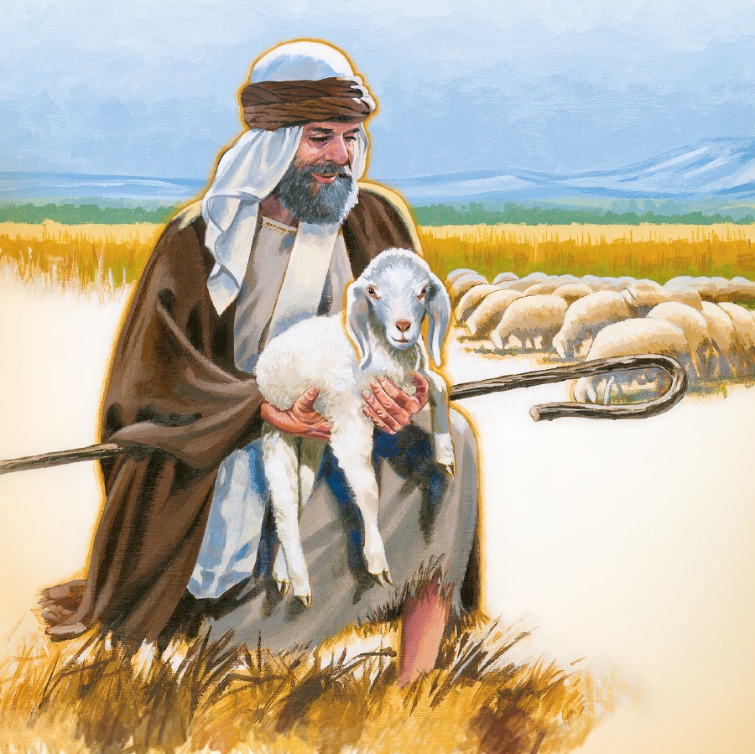
OFFICE OF SHEPHERD?
One who sets a good example
One who watches over us
Been around Life
Been around the Lord
Been around Love
One who equips and edifies

Slide 4
OFFICE OF SHEPHERD?
MAKE TOUGH DECISIONS
STAND FOR THE TRUTH
WALK BY FAITH

