Slide 2
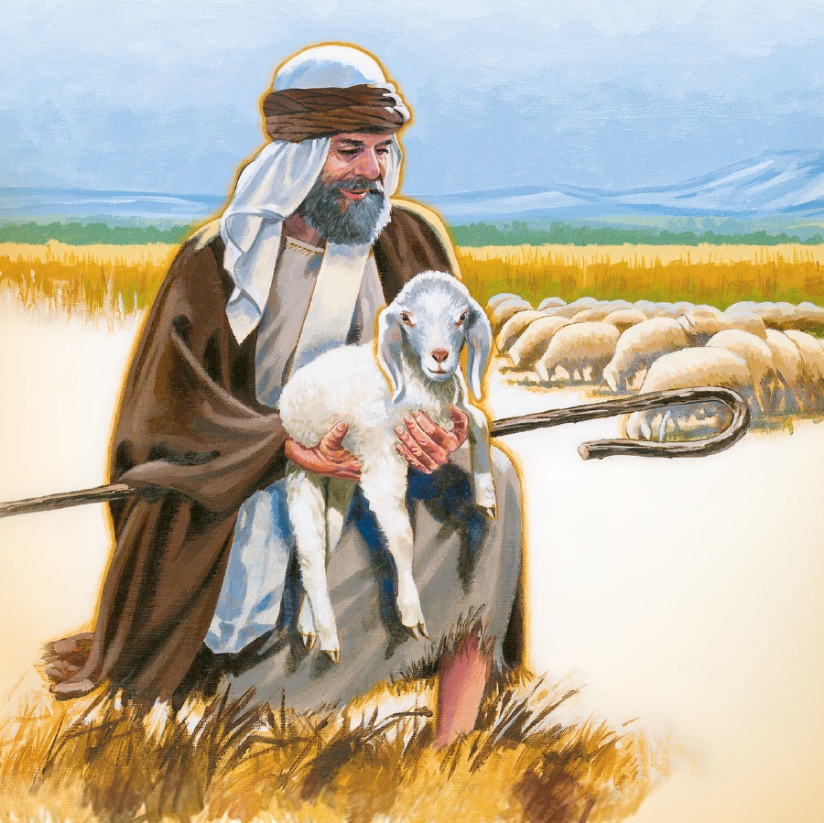
DUTIES OF SHEPHERDS
PROTECTOR
Be Conscious
Be Courageous
Be Compassionate
PROVIDER
PATHFINDER

