Slide 2
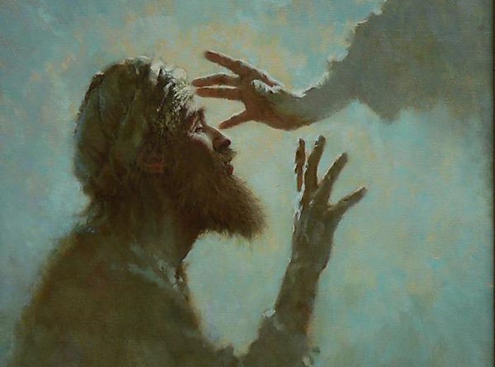
A SECOND TOUCH
Mark
Man
Method
Touched him
Spit on him

Slide 3
A SECOND TOUCH
Mark
Man
Method
Miracle
Message
Master

