Slide 2
LOST IN THE CREDITS
GAMALIEL
ACTS 5
EXTRAORDINARY LESSONS FROM
ORDINARY PEOPLE

Slide 3
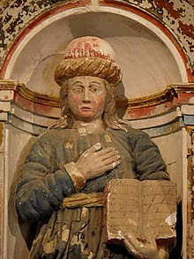
GAMALIEL
Doctor of the Law
Member of the Sanhedrin
A Pharisee
Teacher of Saul
Honored by the people

Slide 4
FAULTY SPEECH OF GAMALIEL
Faulty comparison
Faulty criterion
Faulty conclusion

Slide 5
“The hottest places in hell are reserved for those who in a period of moral crisis maintain their neutrality.”
Dante

